Slide 1
Getting Started
With RISC-V, Fedora, and AI

Slide 2

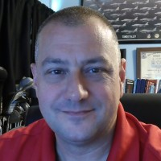
Introductions
Yuning Liang CEO
Deep Computing
Matt St. Onge Associate Principal Solutions Architect
Red Hat

Slide 3

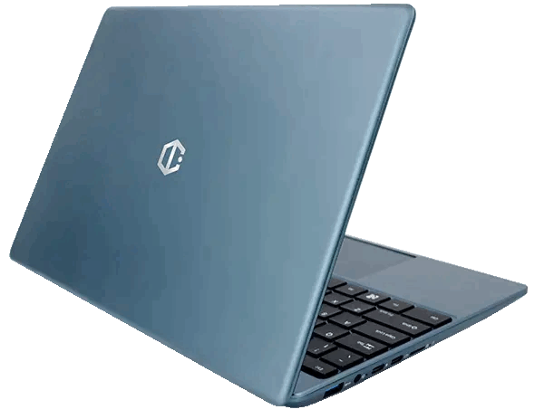
Session Overview
WELCOME!!!
Today we are going to dive
deep into the bleeding edge of
Fedora Linux on RISC-V &
get comfortable with AI…

Slide 4
DISCLAIMER
As of the date this workshop occurs, riscv64 is not an official architecture fully recognized by Fedora.
What we are using is a Fedora Remix - basically the equivalent of Fedora 42 for the riscv64 architecture done on a non-official Koji server…

Slide 5
Creating the Image
Walkthrough

Slide 6
Creating the Fedora Image
Download the DC Roma II Fedora 42 image
https://drive.google.com/file/d/1EN0Zi4rXLGgSnR7Qu8Ymf-qE0hF90AeD/view?usp=sharing

Slide 7
Creating the Fedora Image
Uncompress the downloaded Image file
$ ls -l *.zip
-rw-r--r--. 1 mstonge mstonge 6102037516 Oct 1 19:09 fedora-42-20250908.img.zip
$ unzip fedora-42-20250908.img.zip
$ ls
fedora-42-20250908.img.zip
sdcard.img

Slide 8
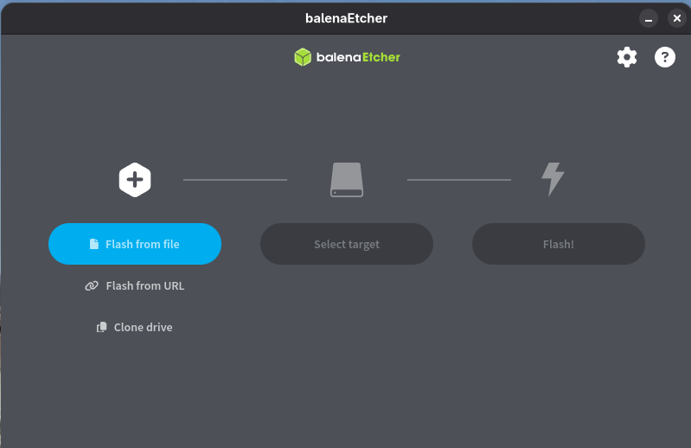
Creating the Fedora Image
Open Balena Etcher
NOTE: If you don’t already have it - download it from here: https://etcher.balena.io/

Slide 9
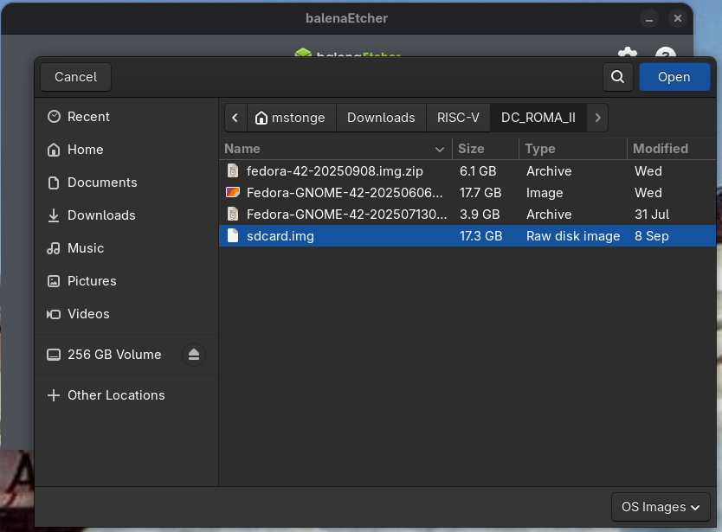
Creating the Fedora Image
Click on Flash from file
Then select the image file you choose to flash with…

Slide 10
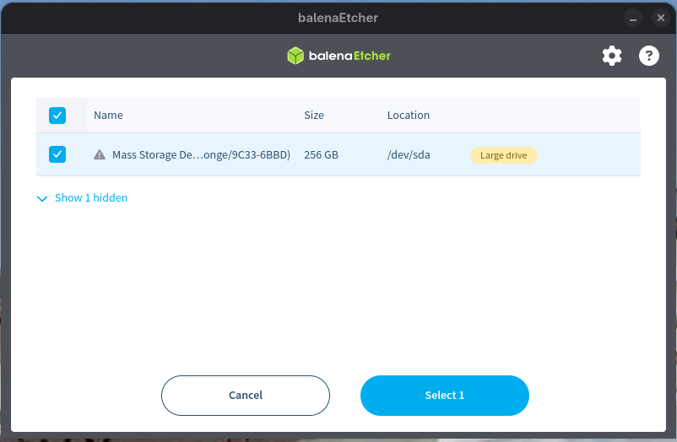
Creating the Fedora Image
Click on Select target
Then select your microSD card
Then click on Select 1

Slide 11
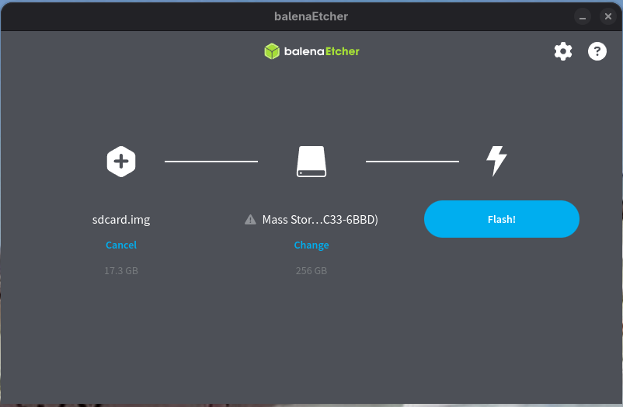
Creating the Fedora Image
Now click on Flash!

Slide 12
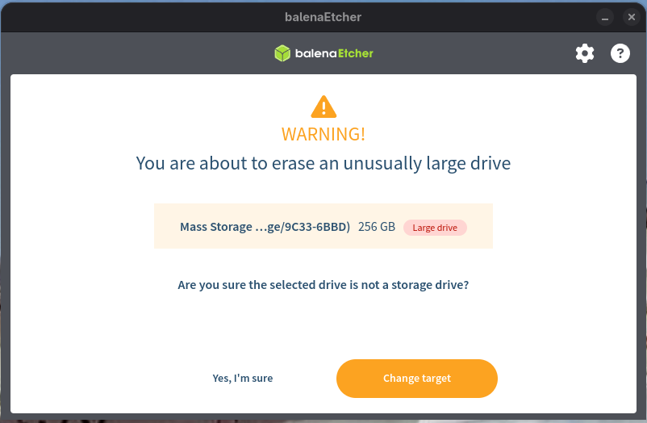
Creating the Fedora Image
Confirm that you want to proceed by clicking on the Yes, I’m sure button…

Slide 13
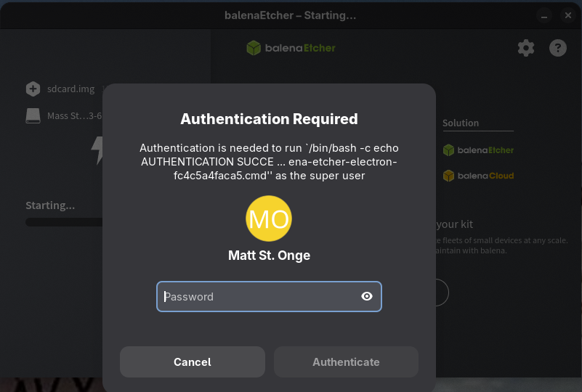
Creating the Fedora Image
The Balena Etcher needs you to authenticate (sudo privileges)... Enter your password…

Slide 14
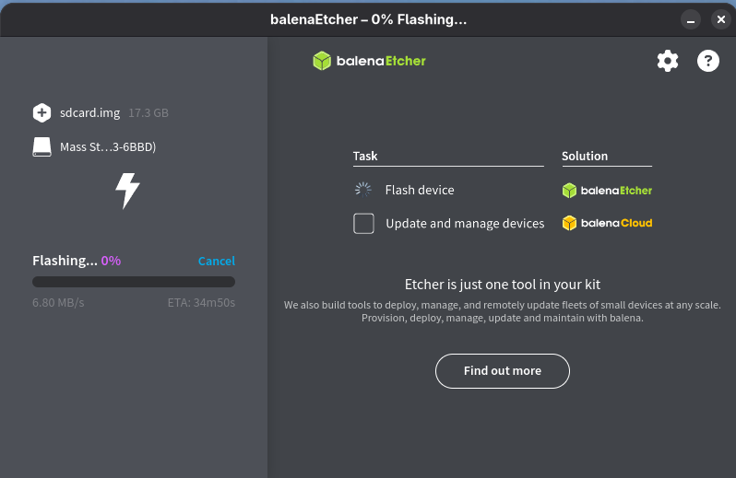
Creating the Fedora Image
Now the waiting game…
The program will flash and verify the image…
This takes a MANY minutes…

Slide 15
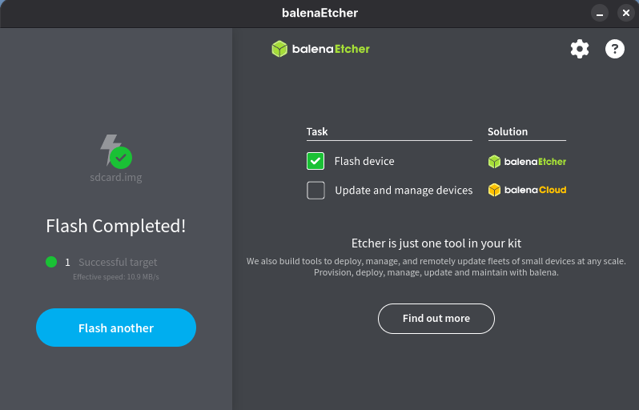
Creating the Fedora Image
Done!!!
You can now remove the media from your machine and close Balena Etcher…

Slide 16
Installing Fedora

Slide 17
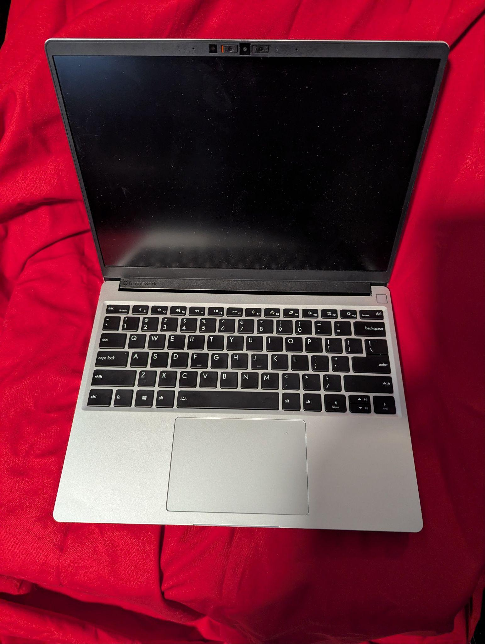
Installing Fedora
Requirements:
DC Roma II Laptop (or Desktop)
Previously flashed Fedora 42 microSd card
#5 torx driver
Smudger

Slide 18
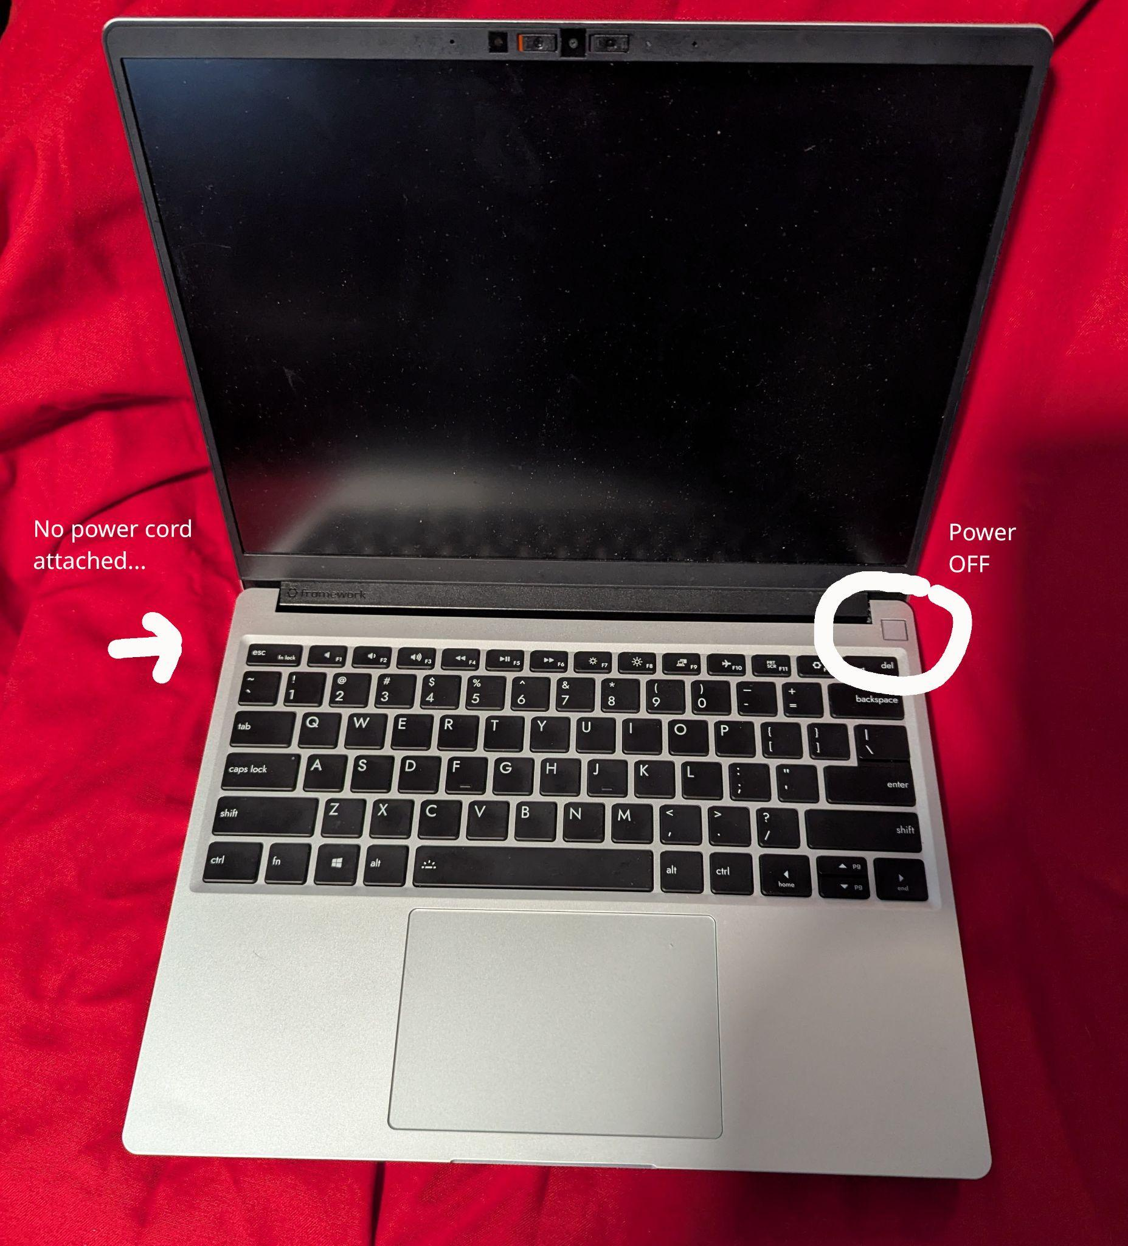
Installing Fedora
Step 1:
Ensure power is OFF

Slide 19
Installing Fedora
Step 2:
Power supply is disconnected
No cables attached

Slide 20
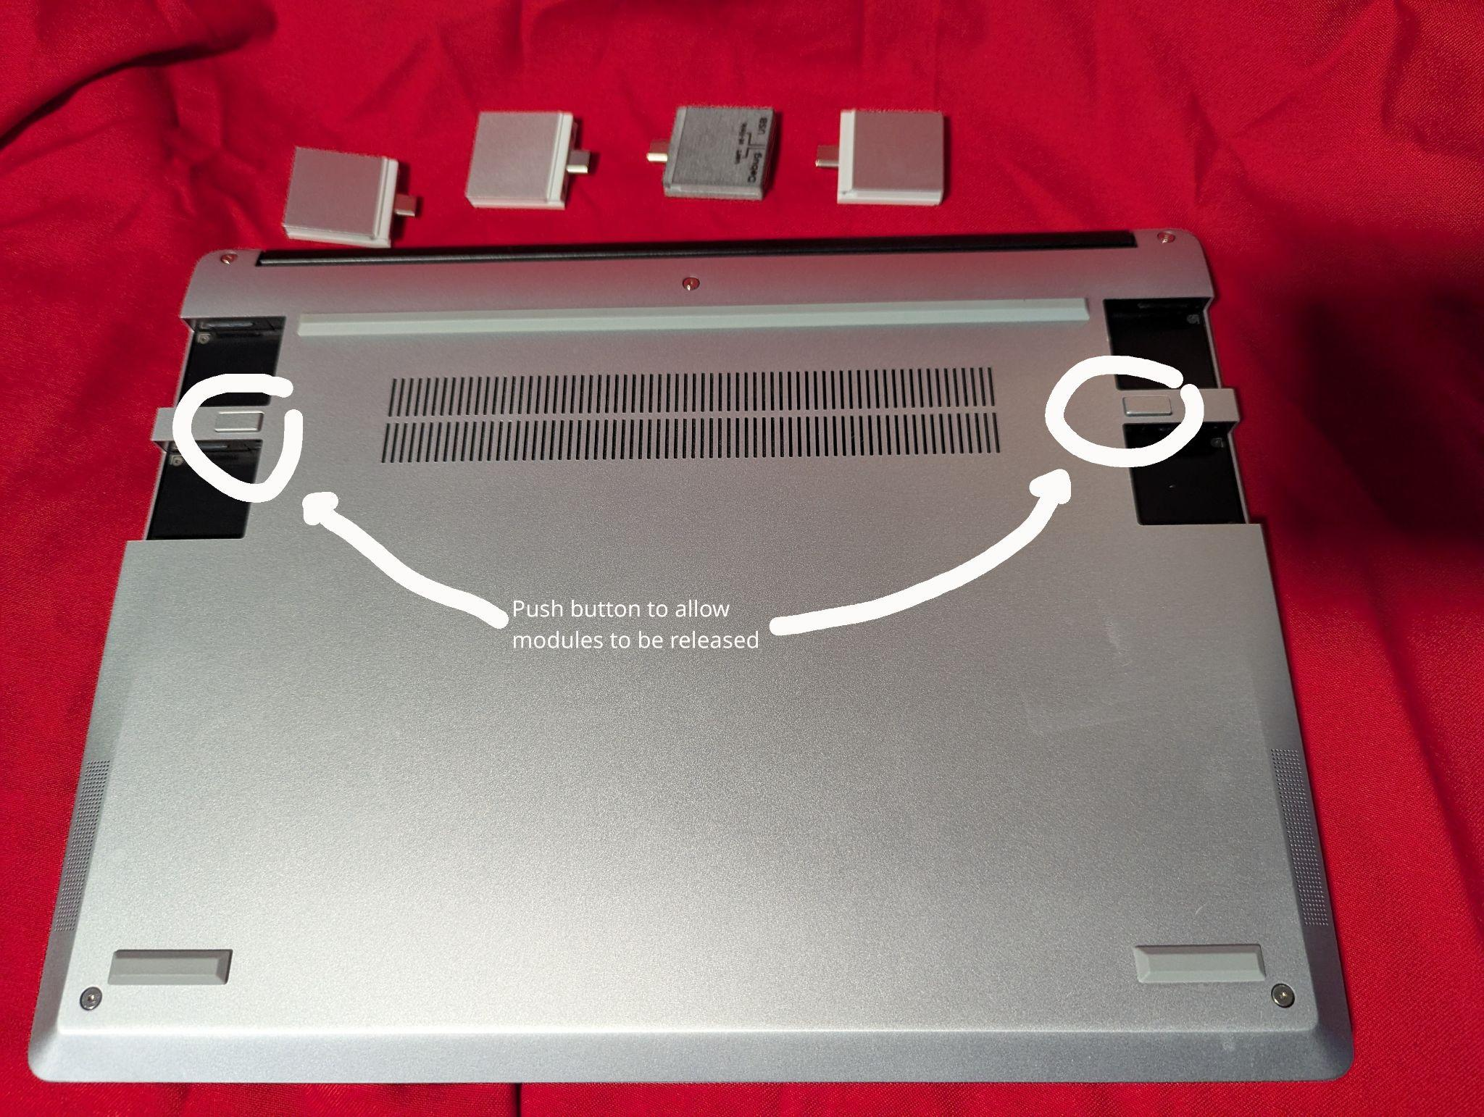
Installing Fedora
Step 3:
Remove all modules

Slide 21
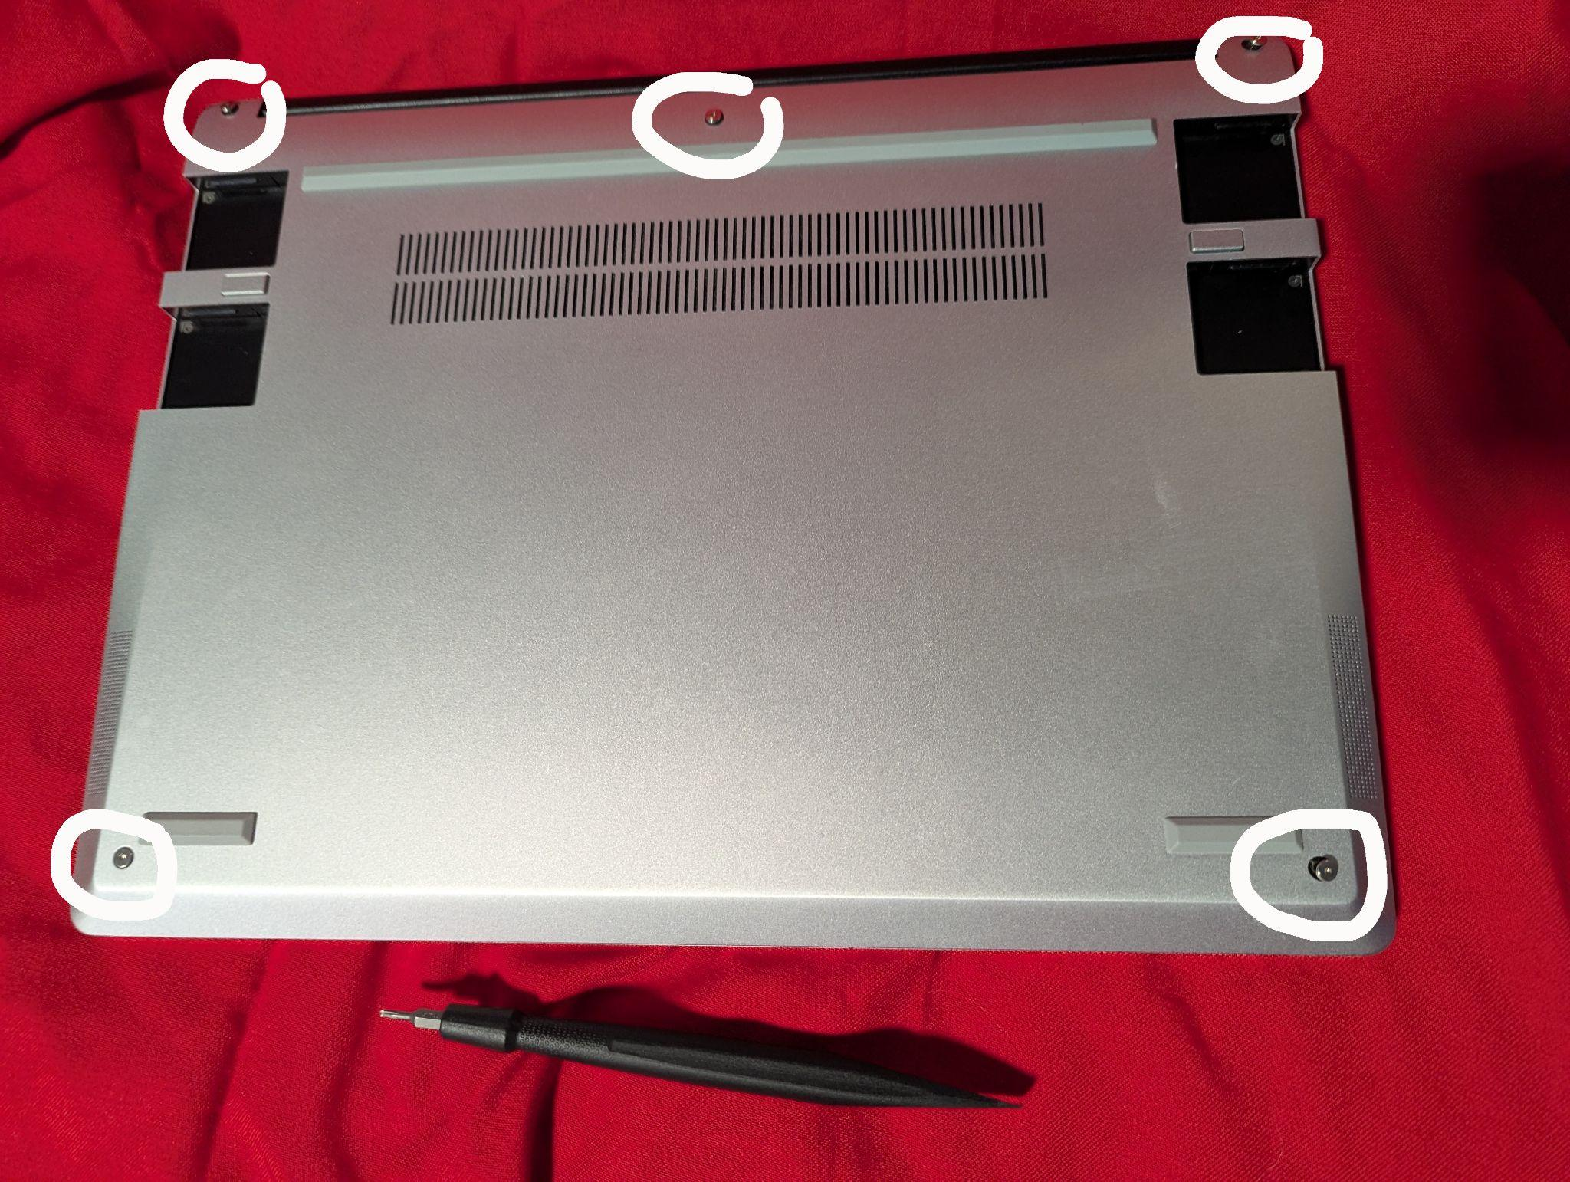
Installing Fedora
Step 4:
On the bottom, there are 5 screws - unscrew them with the torx bit.
PLEASE NOTE: They will not come out all the way (by design)

Slide 22
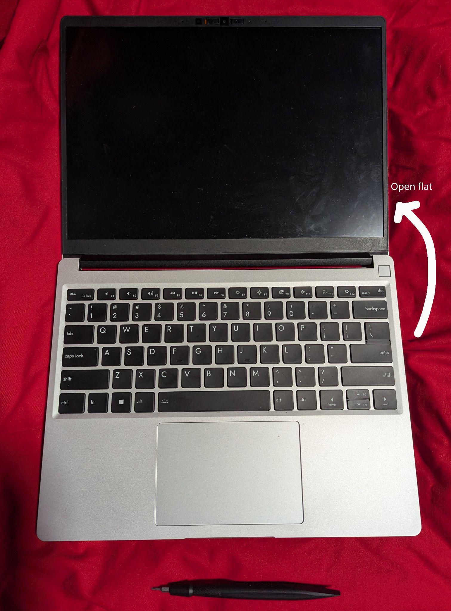
Installing Fedora
Step 5:
Gently flip the laptop over.
Carefully, open it flat on the
table…

Slide 23
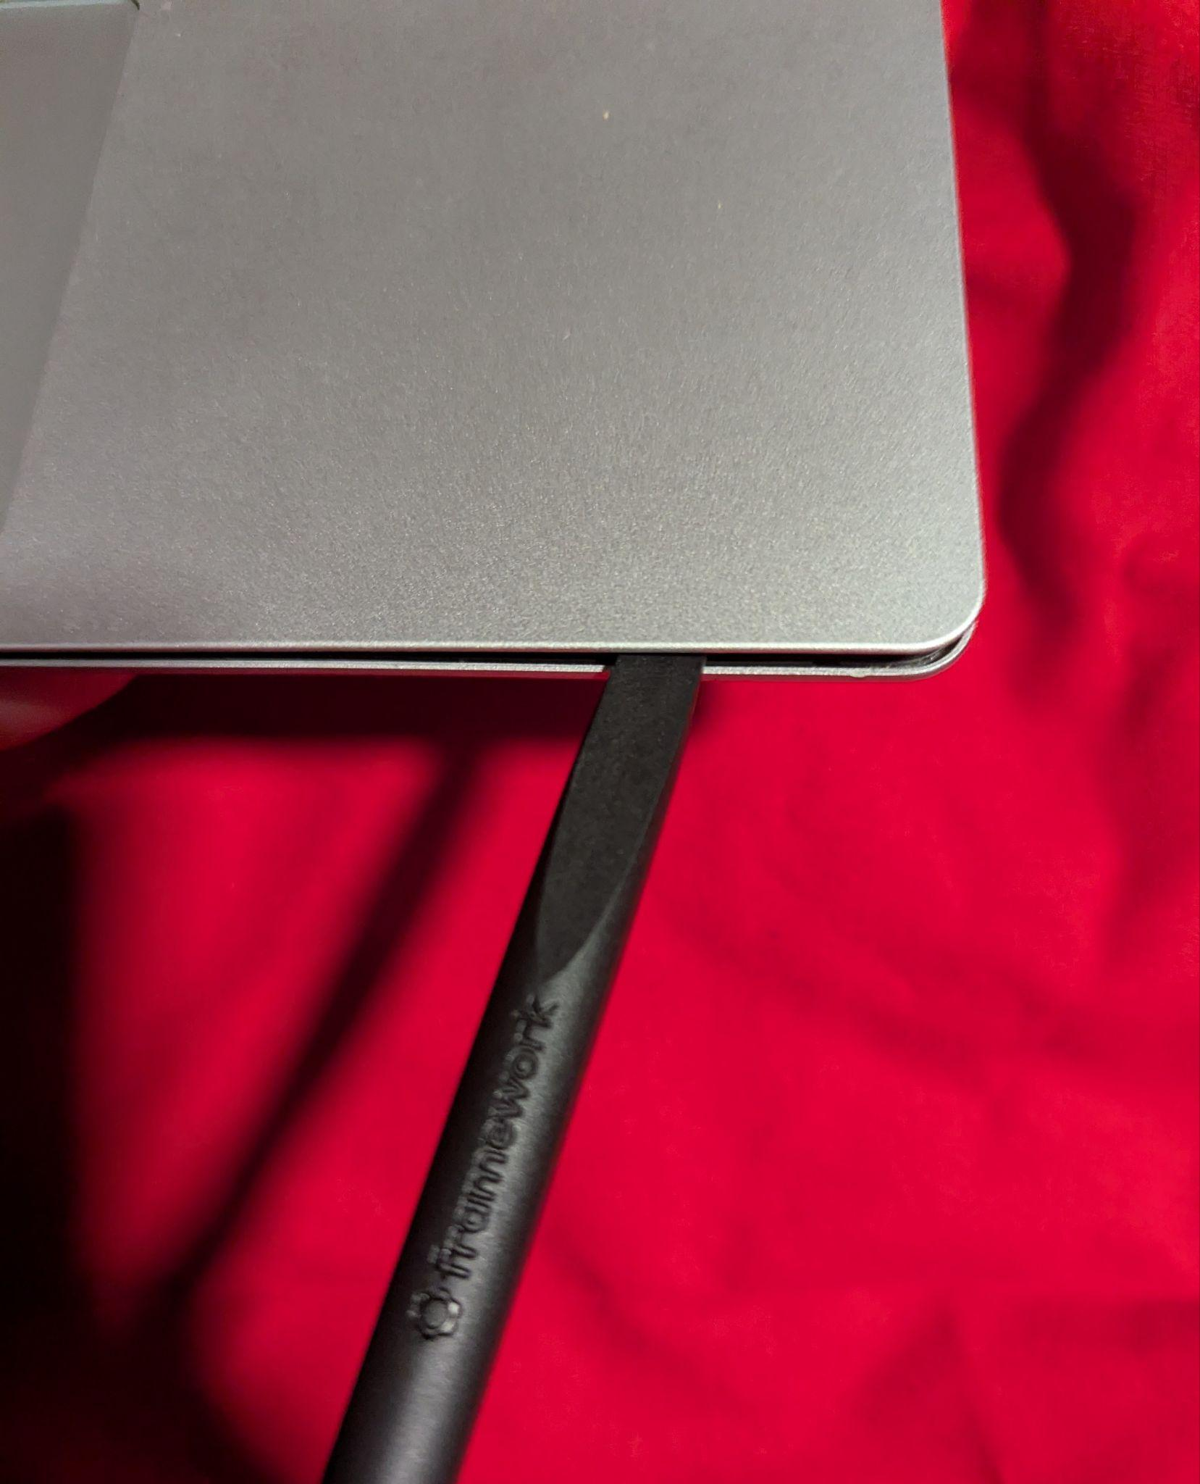
Installing Fedora
Step 6:
Gently use the smudger to
separate the keyboard from
the base.
PLEASE NOTE: You must use extreme
caution as the ribbon cable from the
keyboard is attached to the mainboard.

Slide 24
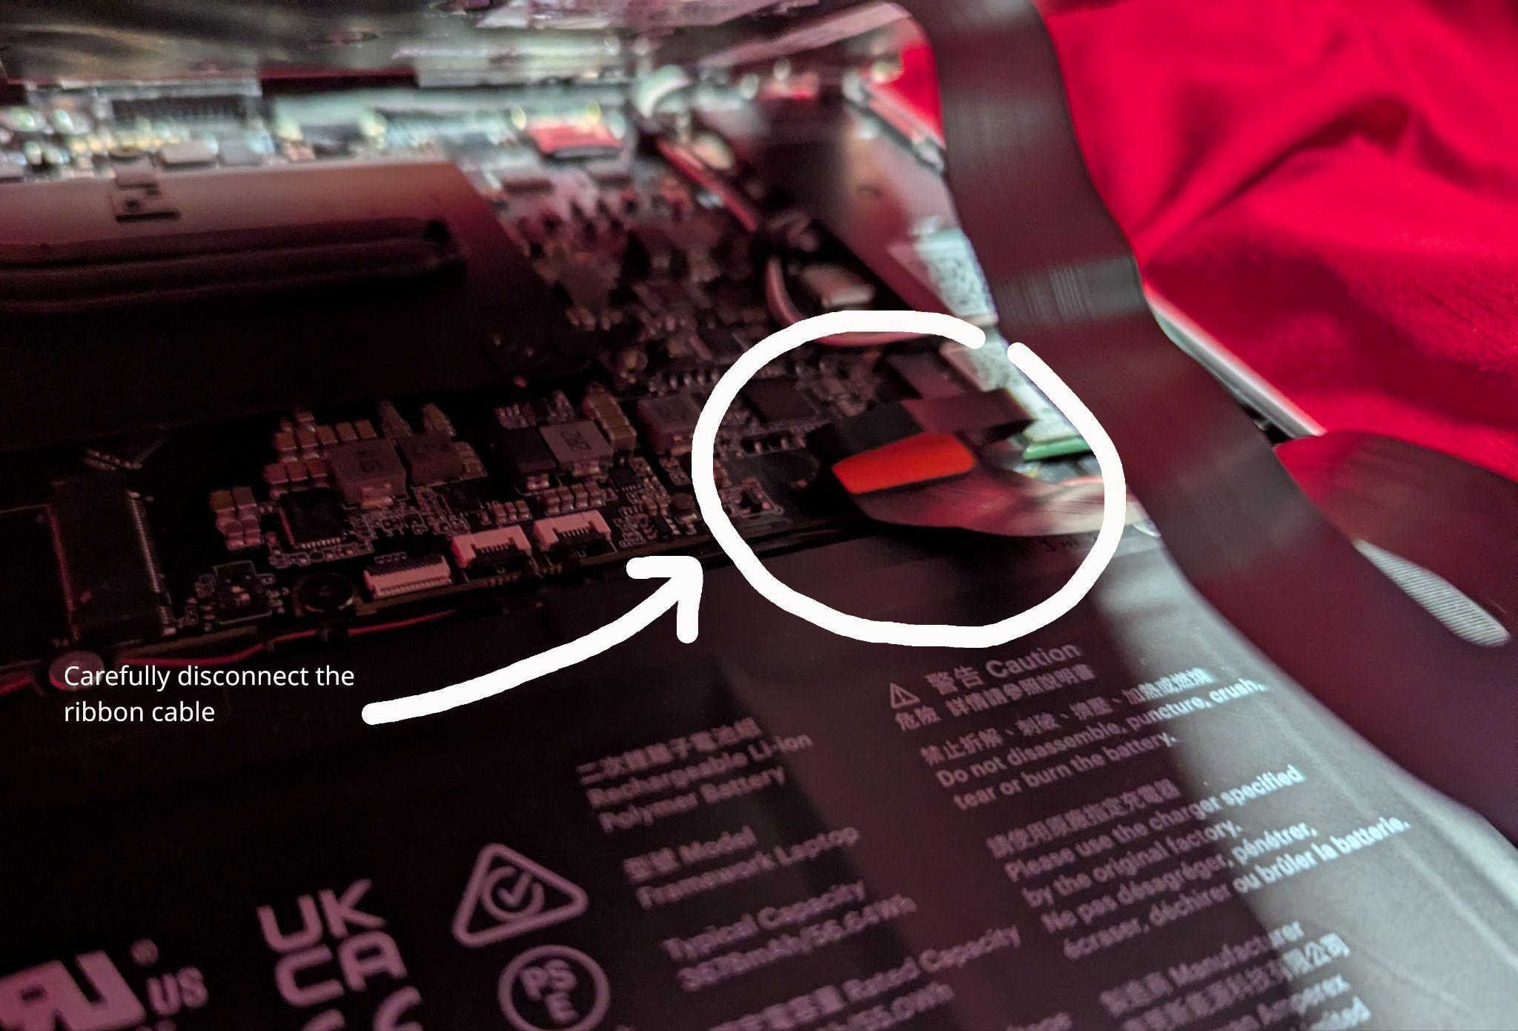
Installing Fedora
Step 6:
Only lift the keyboard enough
to be able to disconnect the
ribbon cable safely.
Place the keyboard gently
aside…

Slide 25
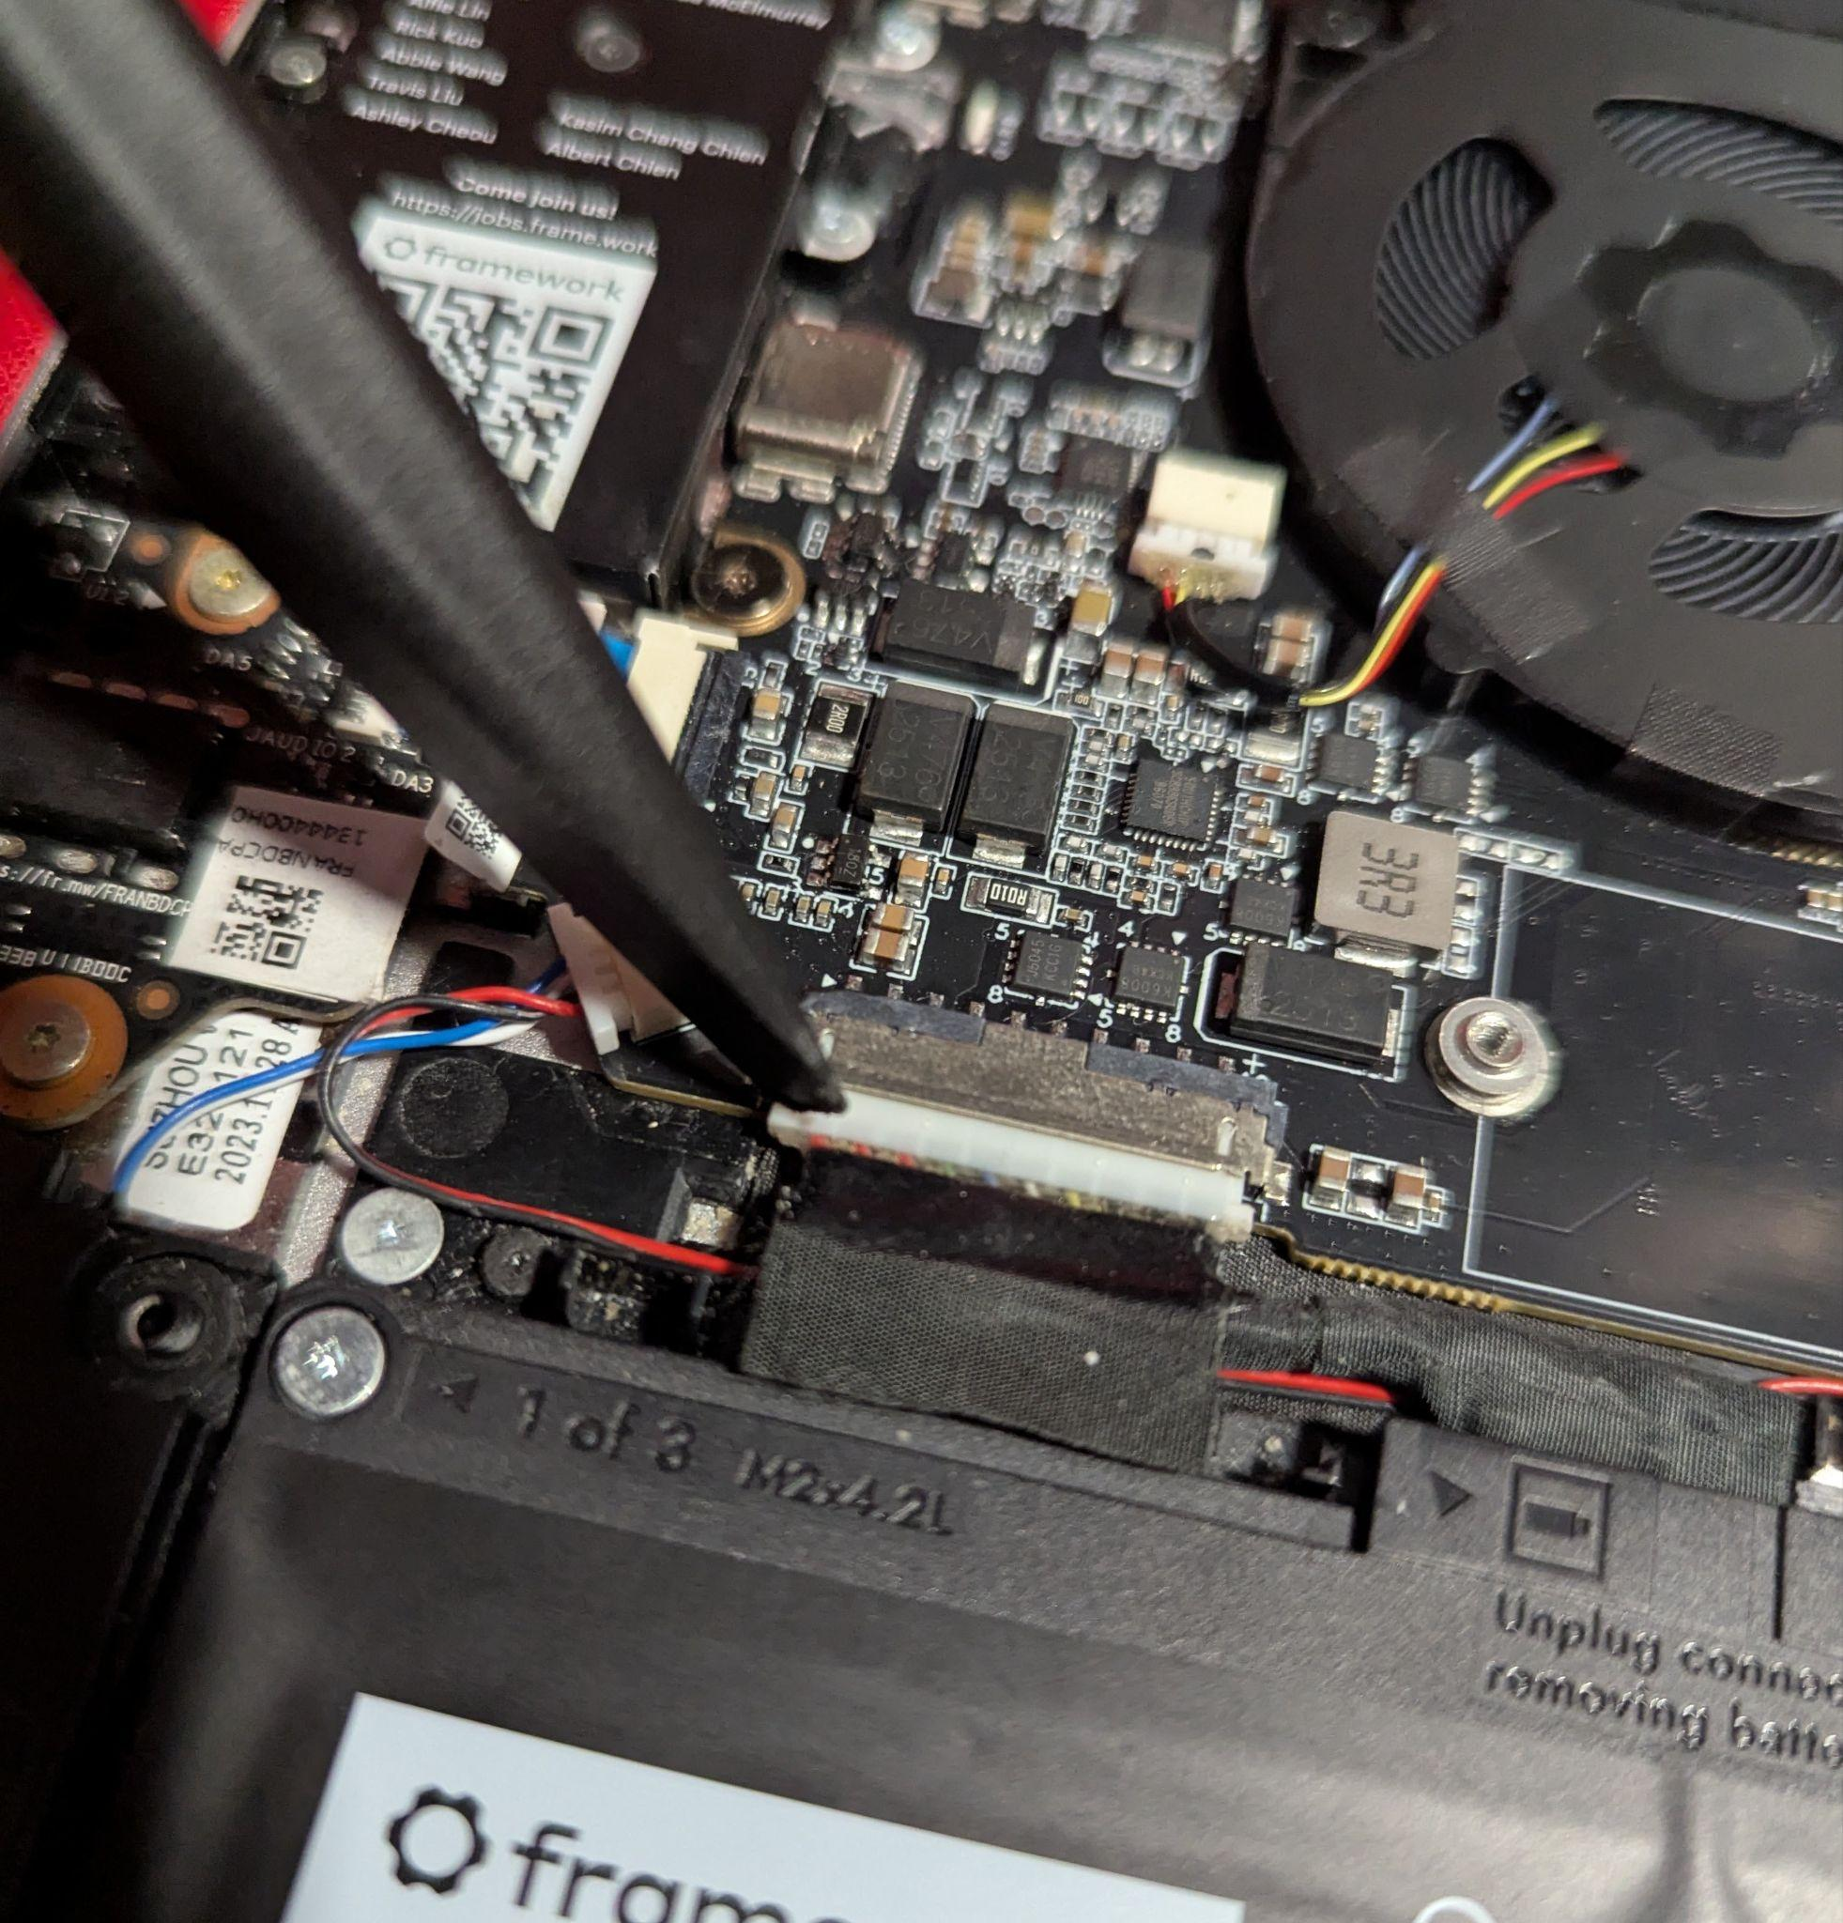
Installing Fedora
Step 7:
Using the smudger…
Gently disconnect the
battery.

Slide 26
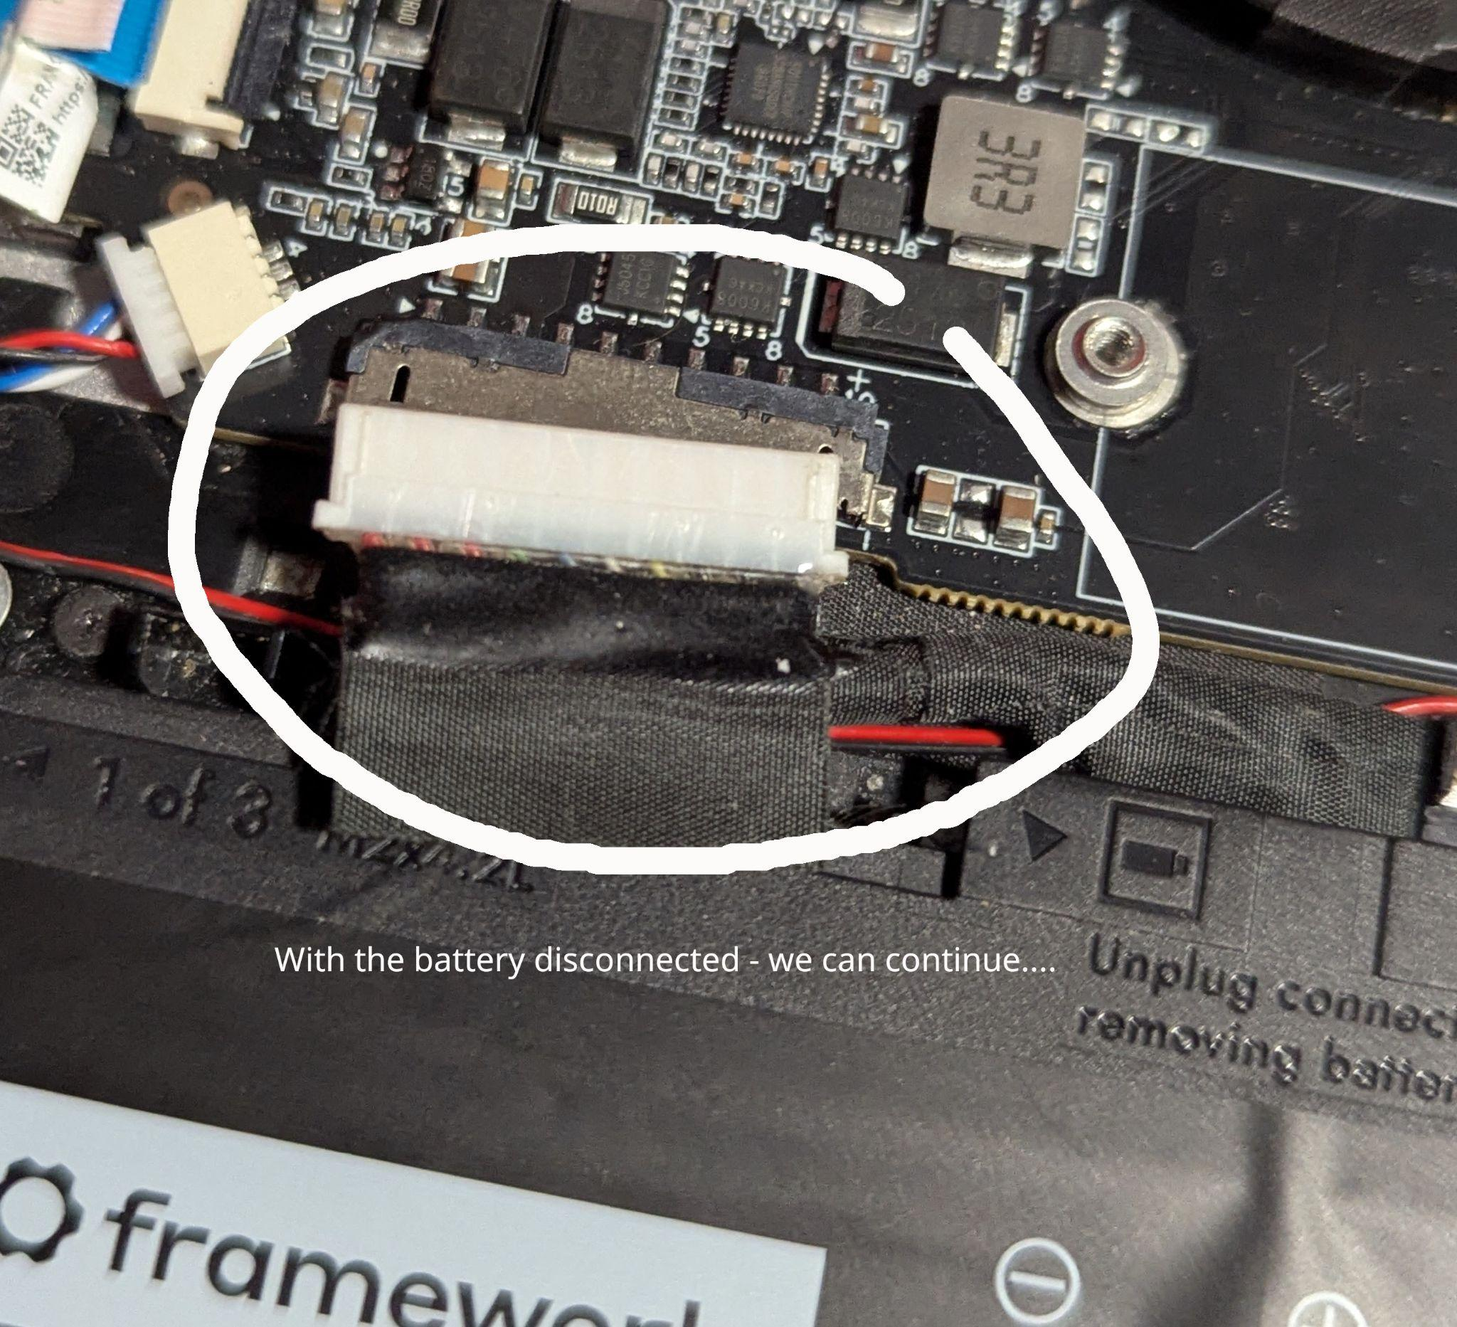
Installing Fedora
Step 7:
WIth the battery safely
disconnected, we can
continue…

Slide 27
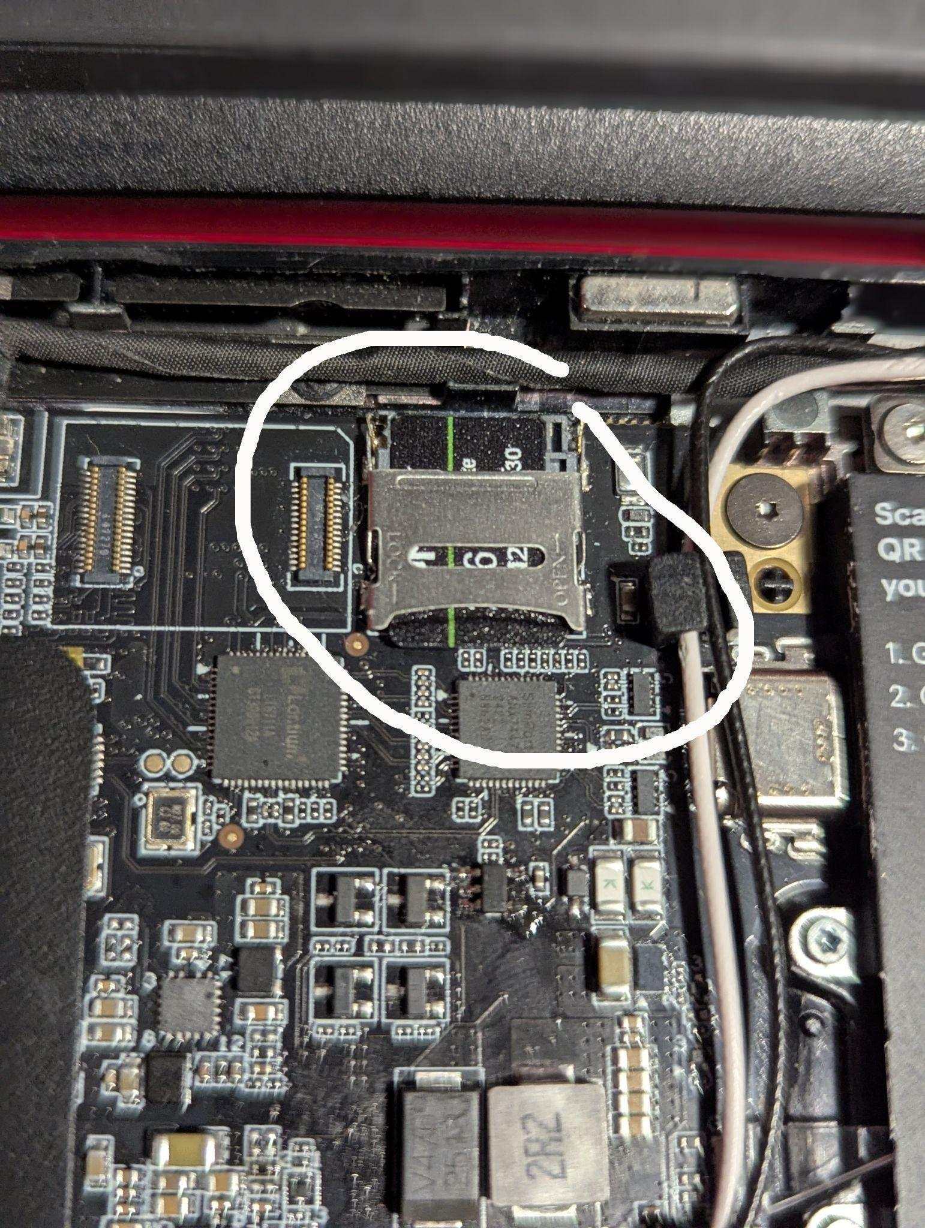
Installing Fedora
Step 8:
Now, we’ll use the smudger
to gently open the metal
bracket that secures the
microSD card.

Slide 28
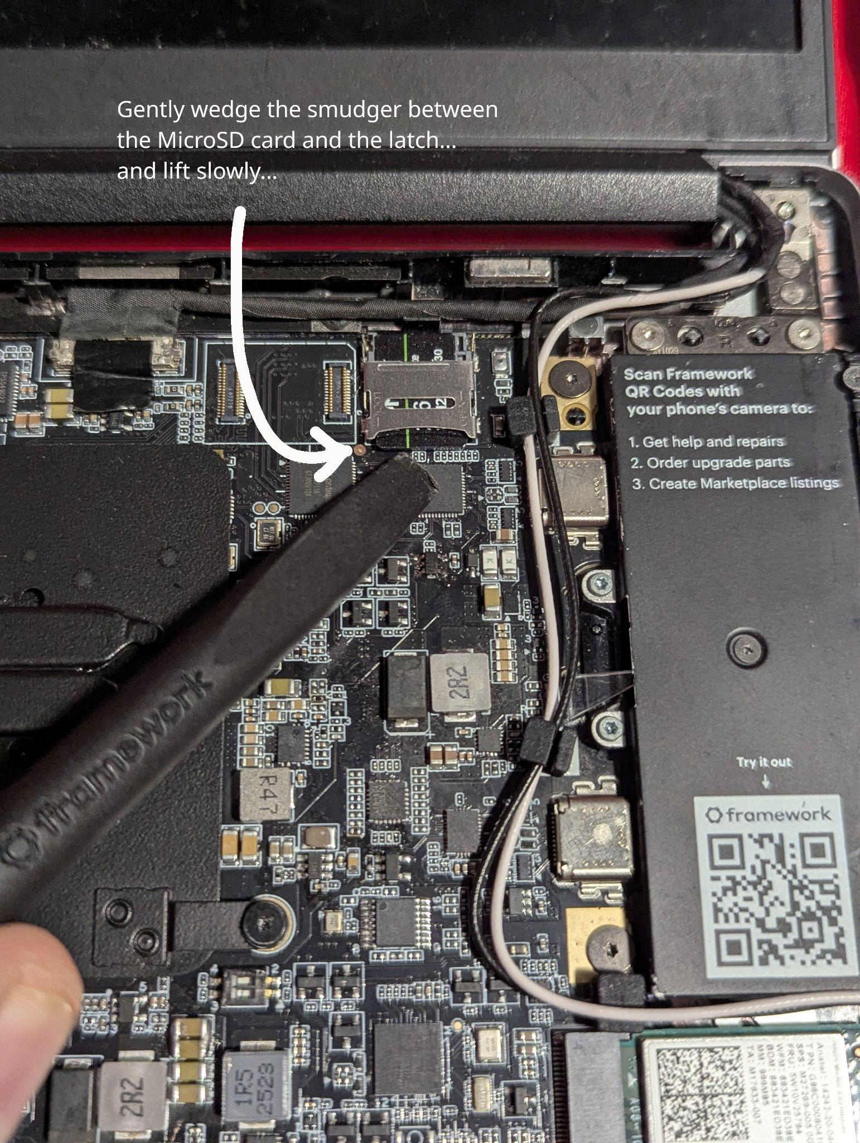
Installing Fedora
Step 8:
Please Note: Use Extreme
Caution. Gently lift the latch &
do not remove it!!

Slide 29
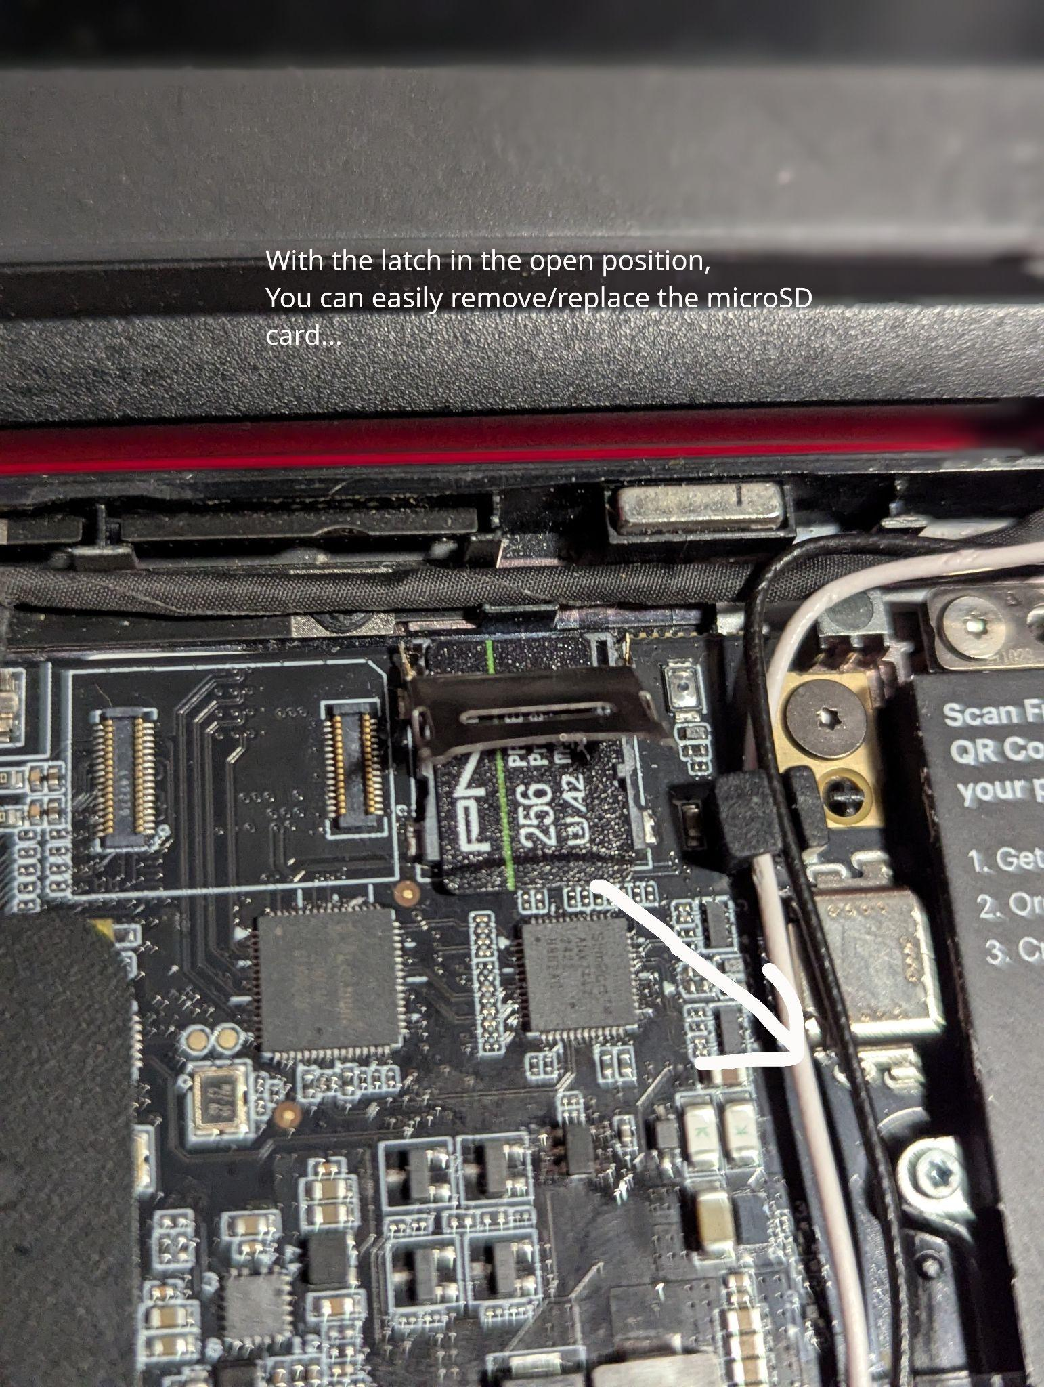
Installing Fedora
Step 9:
Remove the old microSD
card (if present)...

Slide 30
Installing Fedora
Step 10:
Place the NEW (Fedora 42)
microSD card into the slot.

Slide 31
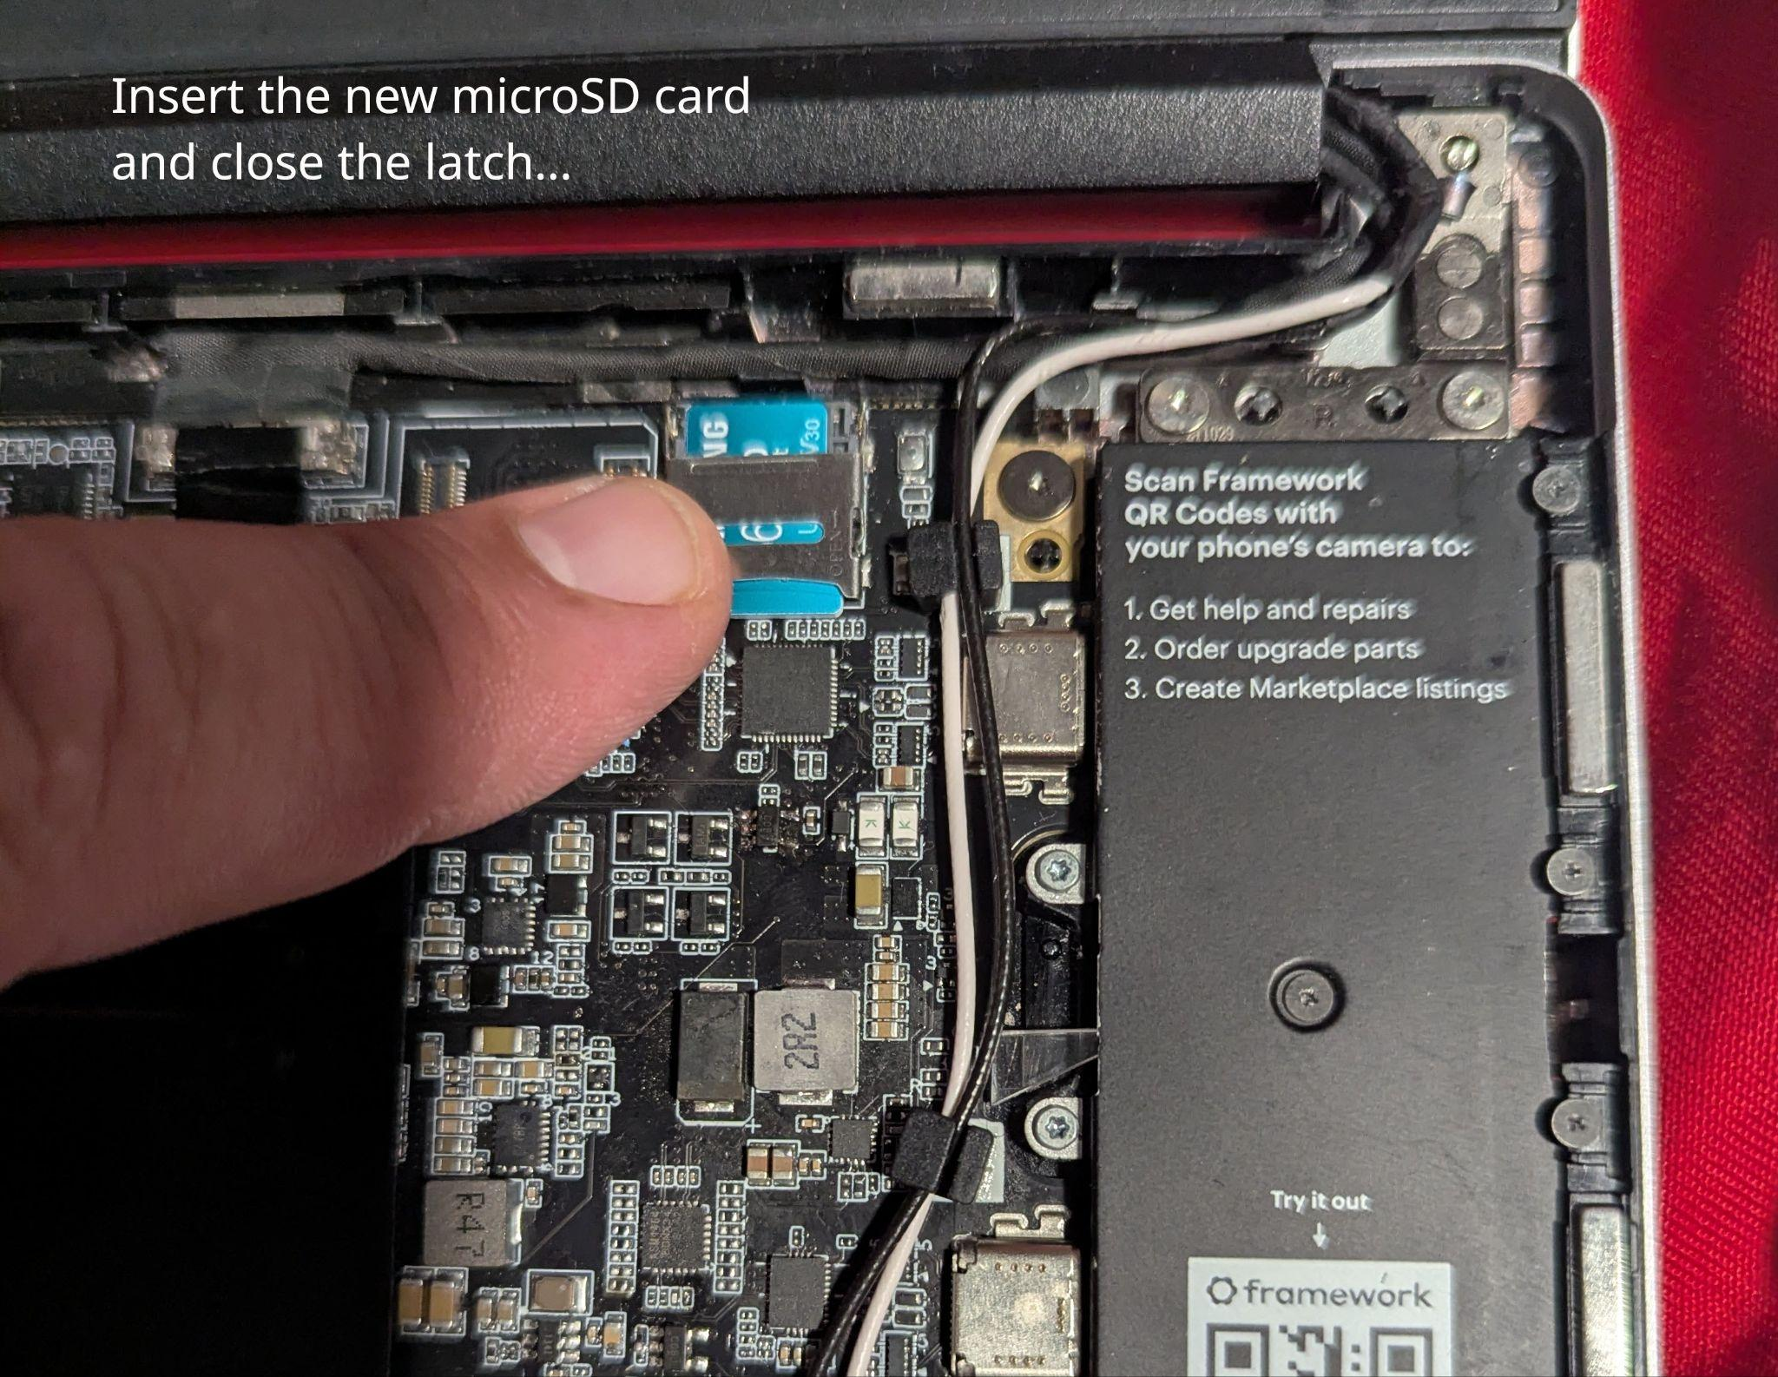
Installing Fedora
Step 11:
Gently close the card latch…

Slide 32
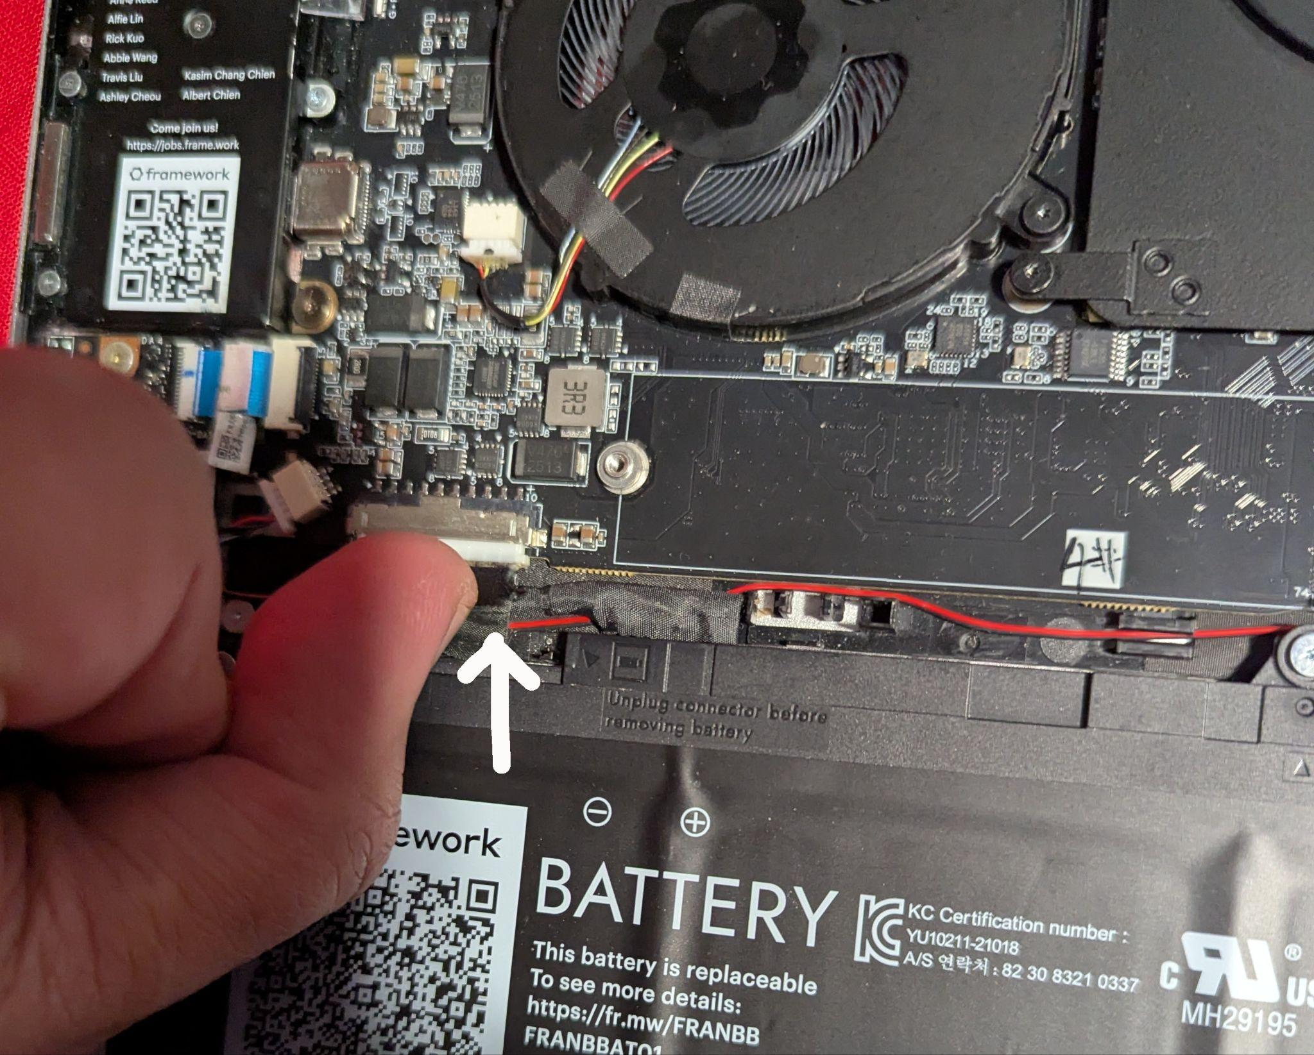
Installing Fedora
Step 12:
Reconnect the battery…

Slide 33
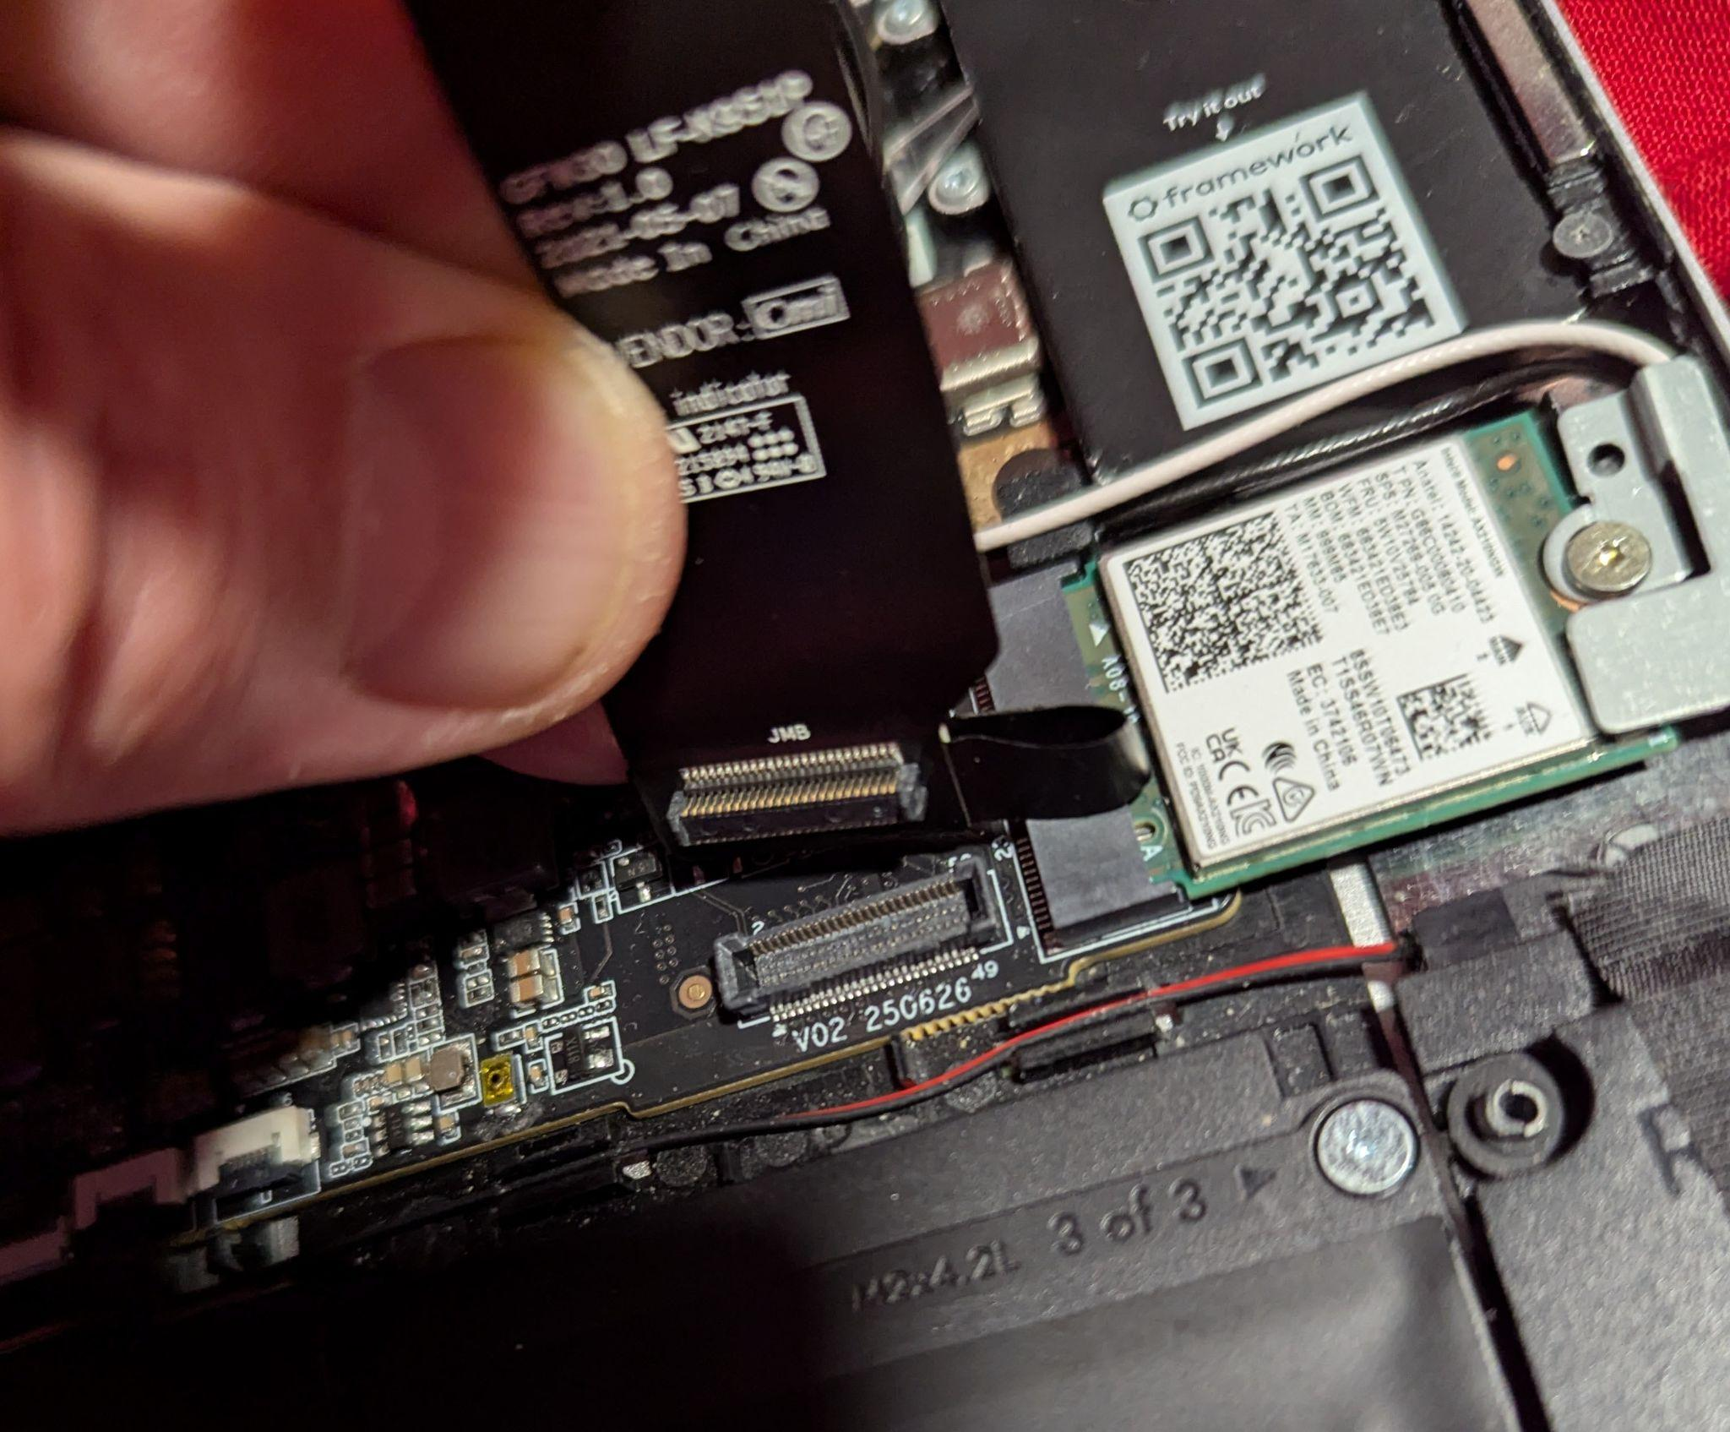
Installing Fedora
Step 13:
Reconnect the keyboard’s
ribbon cable…

Slide 34
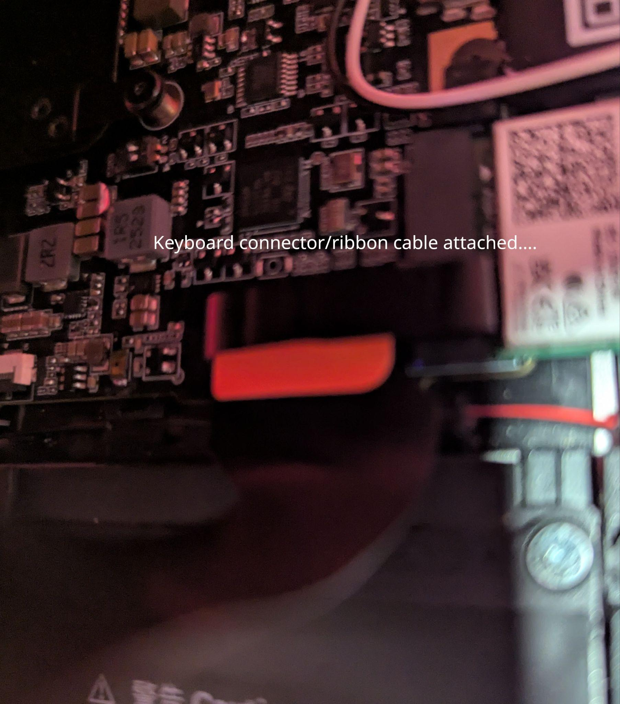
Installing Fedora
Step 13:
The ribbon connector should
easily go back into place…

Slide 35
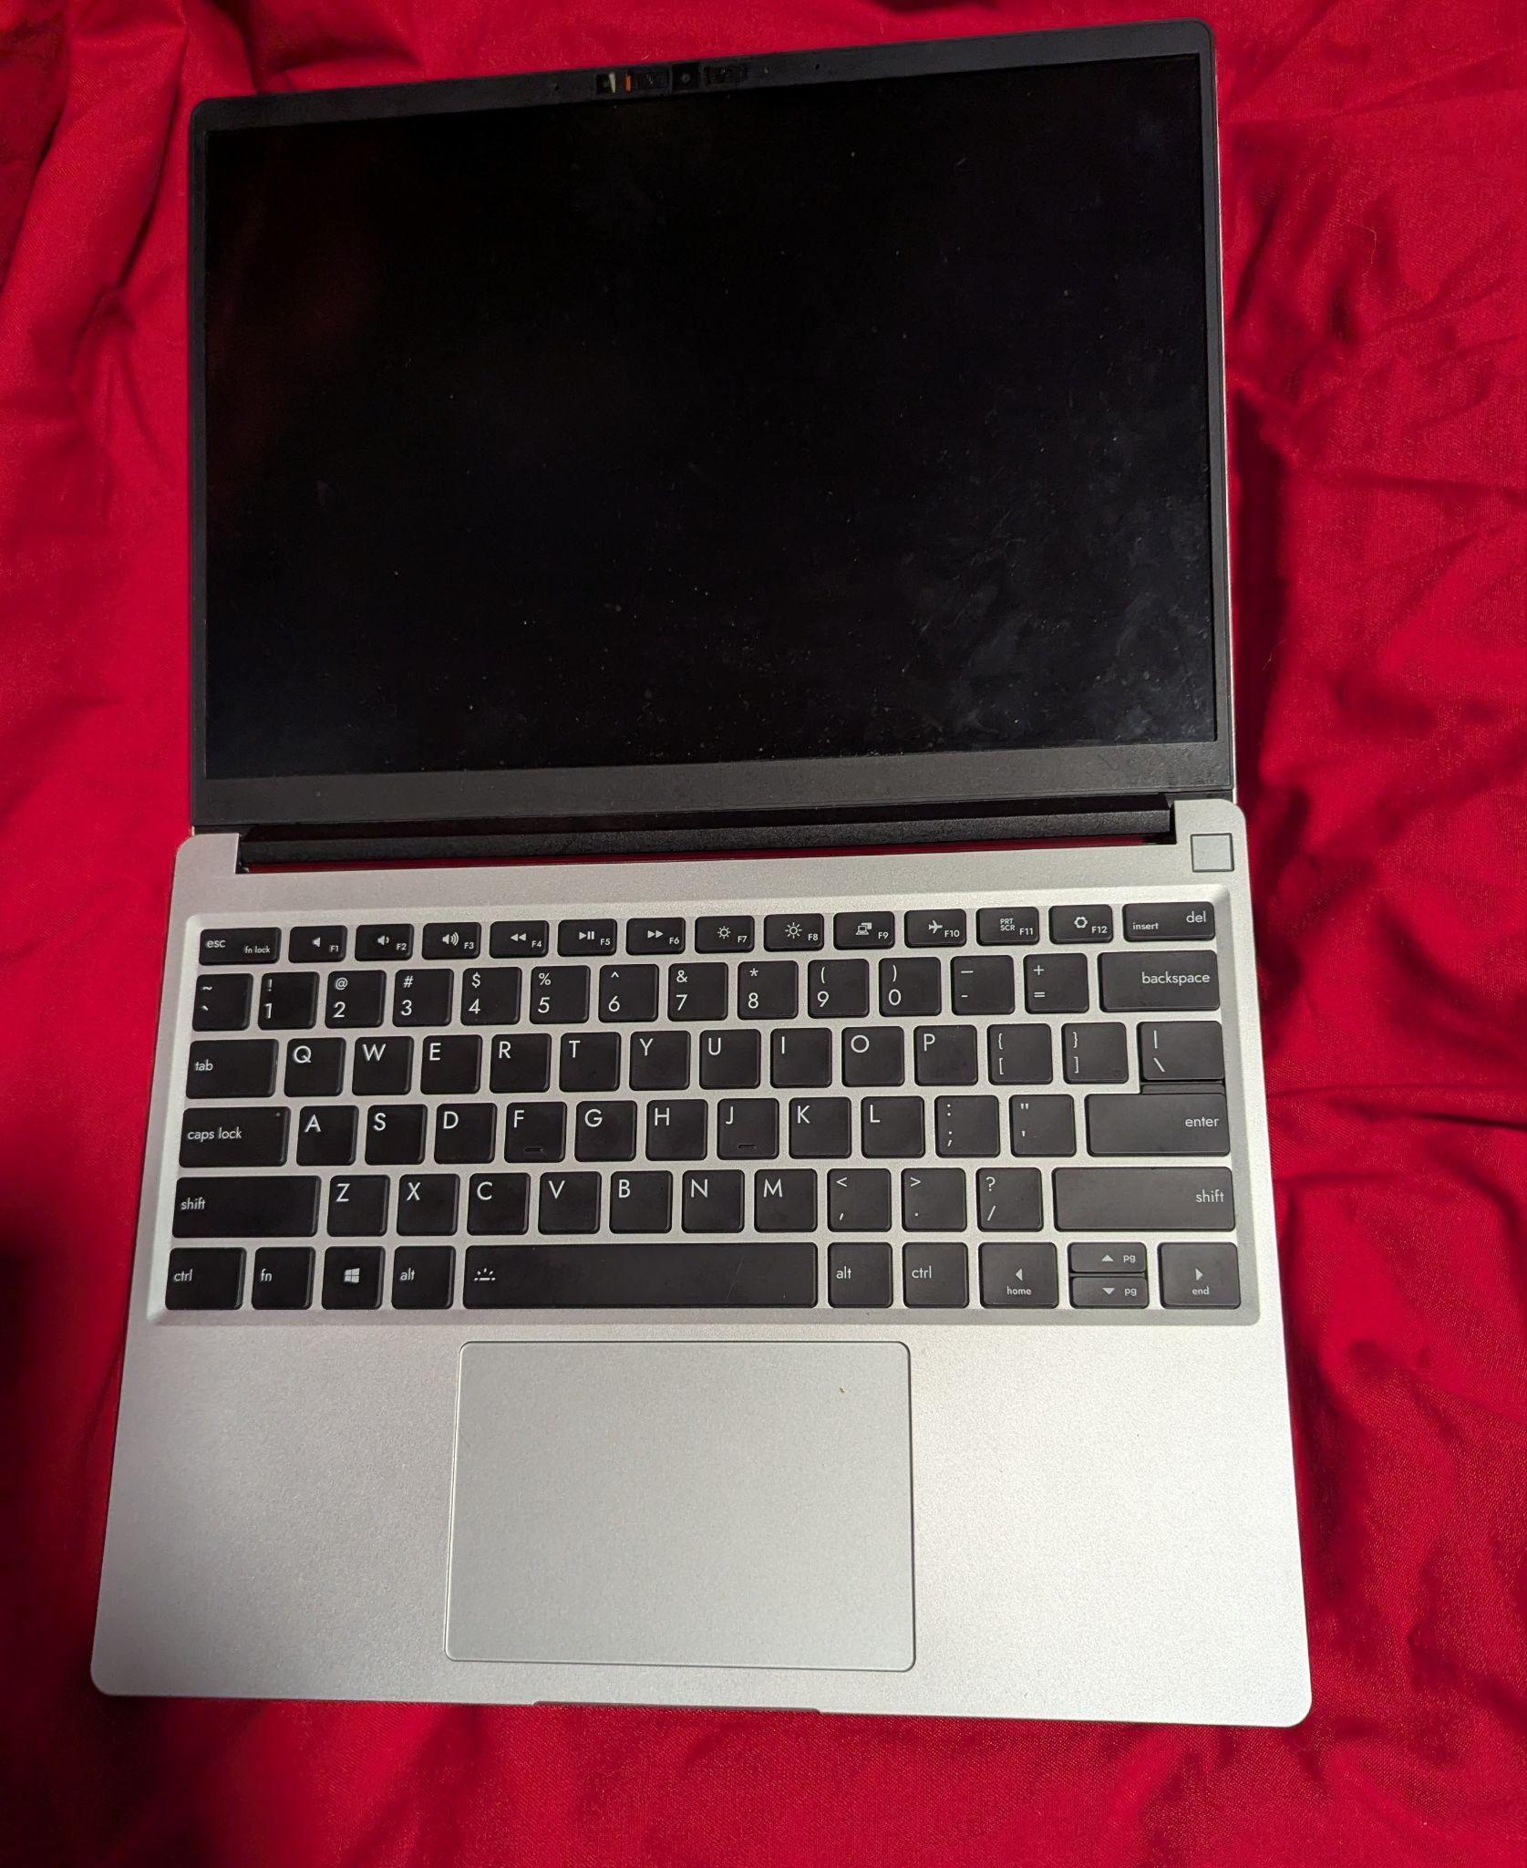
Installing Fedora
Step 14:
Realign the keyboard into
its place…
Then carefully close it and
flip it over…

Slide 36
Installing Fedora
Step 15:
Gently secure the 5 screws.
PLEASE NOTE: Do not over
tighten them as it could
damage the laptop…

Slide 37
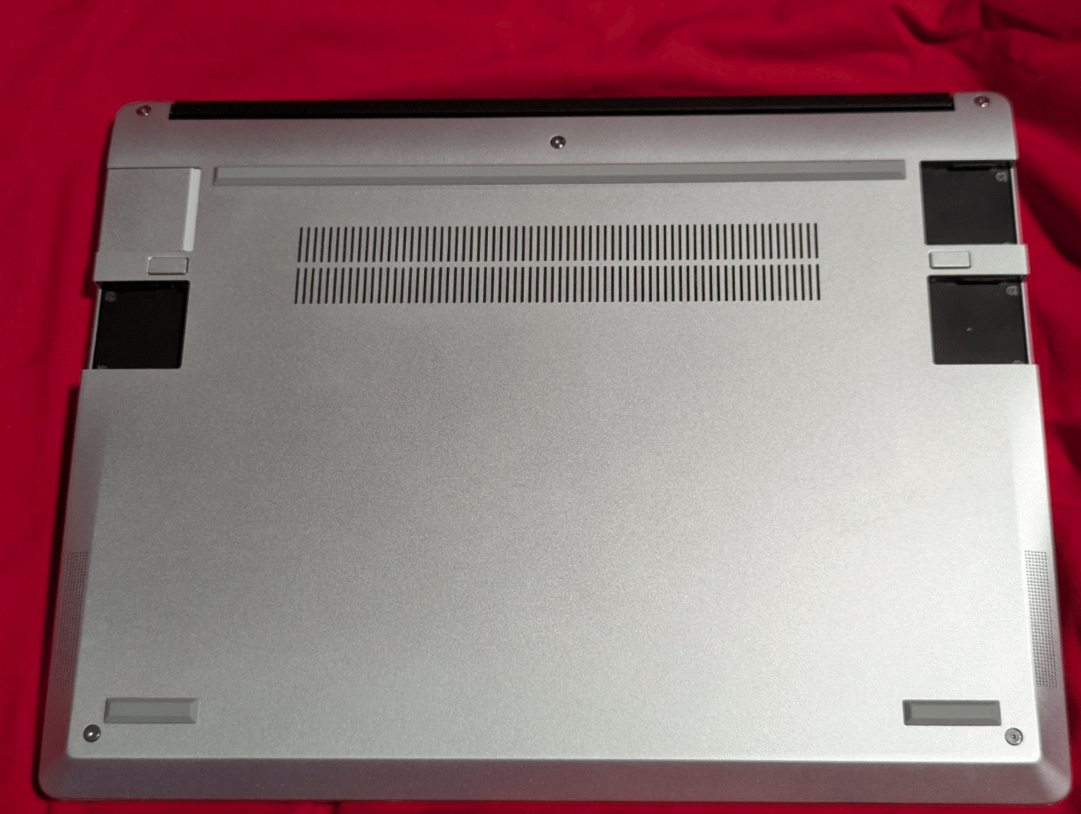
Installing Fedora
Step 16:
Replace the modules back
into their slots…

Slide 38
Installing Fedora
Step 17:
Flip the machine back over.
Reconnect the power supply.

Slide 39
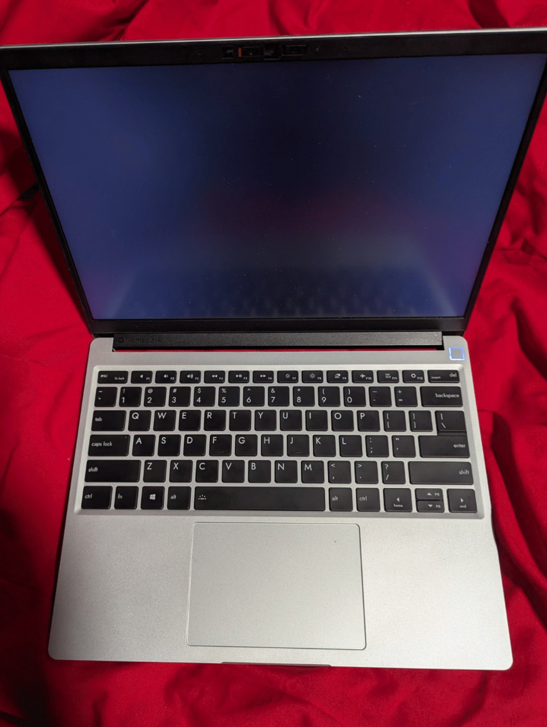
Installing Fedora
Step 18:
Press the power button
to boot the computer…
(do not login yet)

Slide 40
Optimization

Slide 41
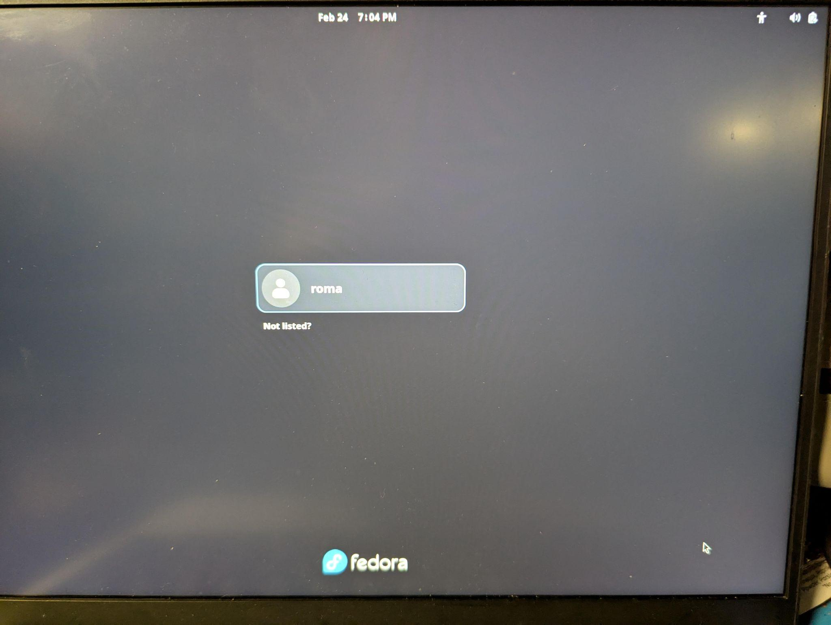
Optimization
STEP 1:
Initial Login
User: roma
Password: roma

Slide 42
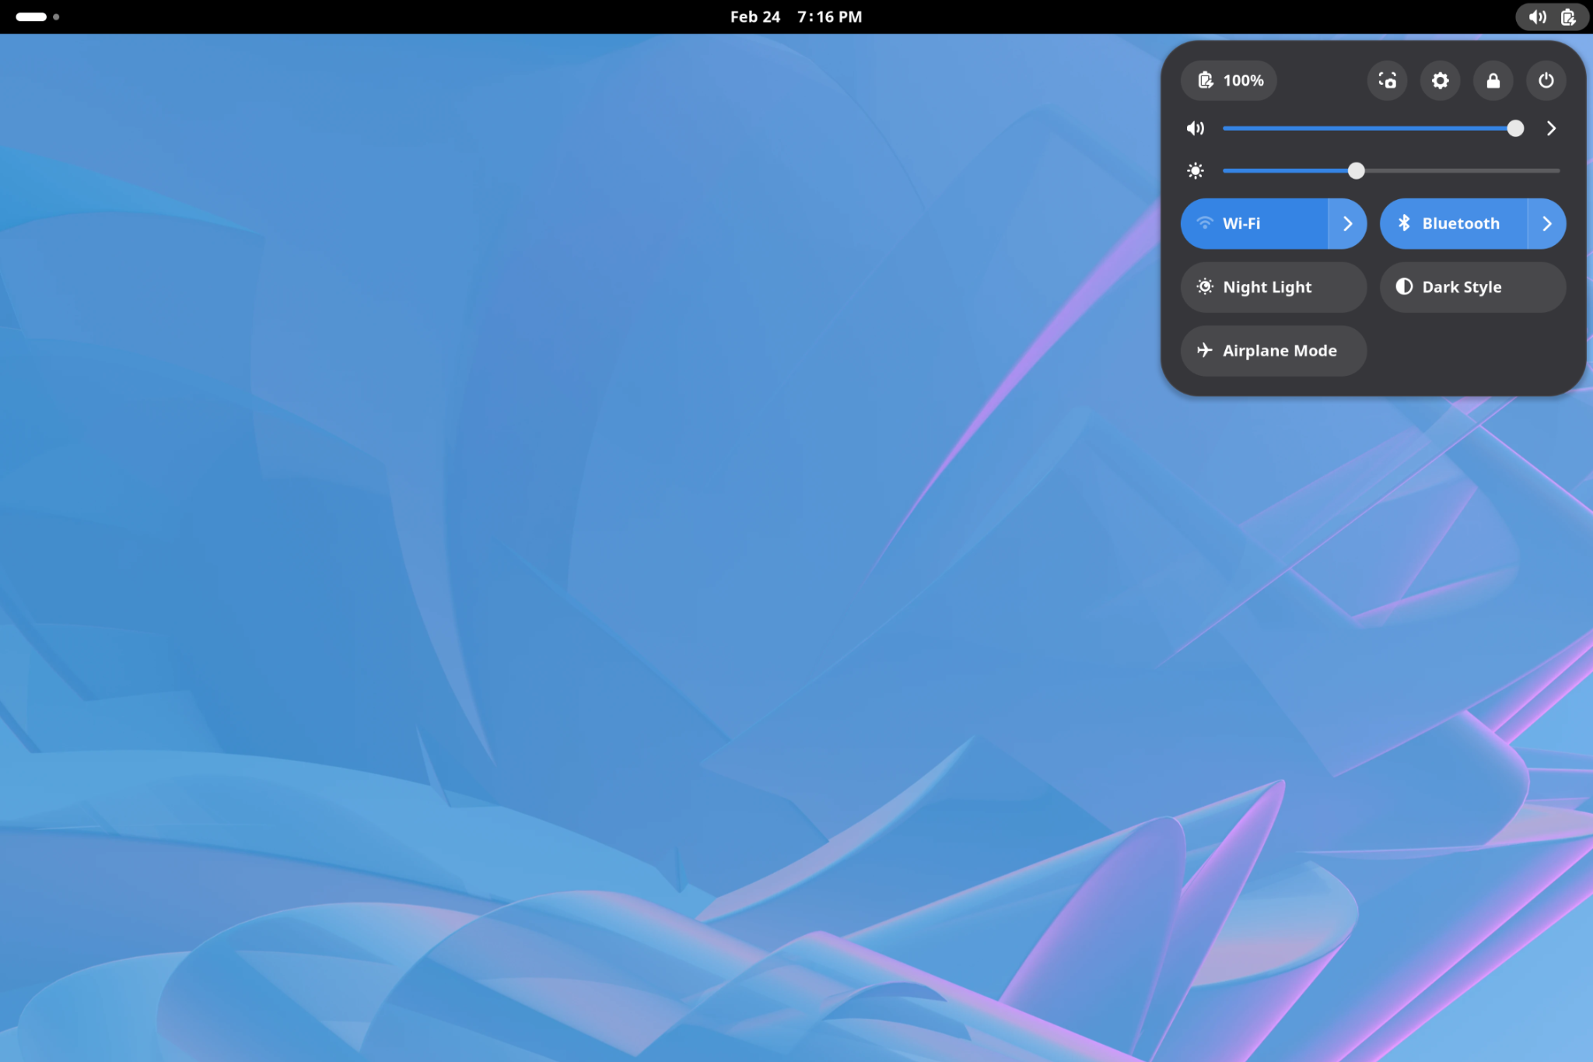
Optimization
STEP 2:
Configure Wireless
Networking
(WIFI info TBD)

Slide 43
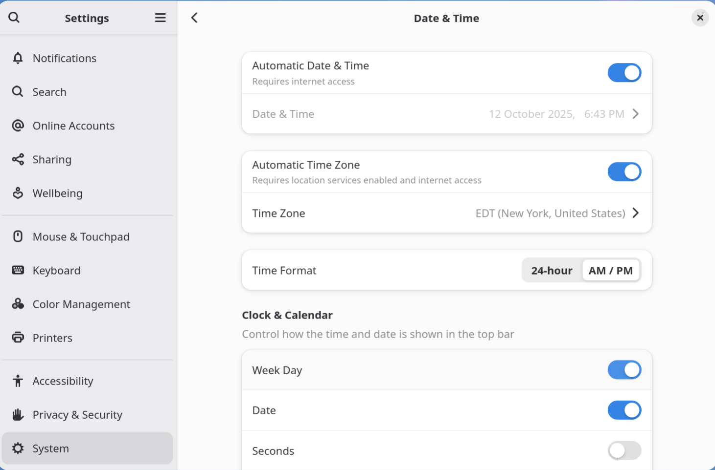
Optimization
STEP 3:
Configuring Date / Time

Slide 44

Optimization
STEP 4:
Disable Bluetooth

Slide 45
Optimization
STEP 5:
Custom repository
configuration
((OPTIONAL))

Slide 46
Optimization
STEP 6:
Initial package installs & UI
tweaks
$ sudo -i
(enter roma password when prompted)
# dnf install -y gnome-tweaks
(output omitted)
# dnf install -y info btop
# exit
$ gnome-tweaks

Slide 47
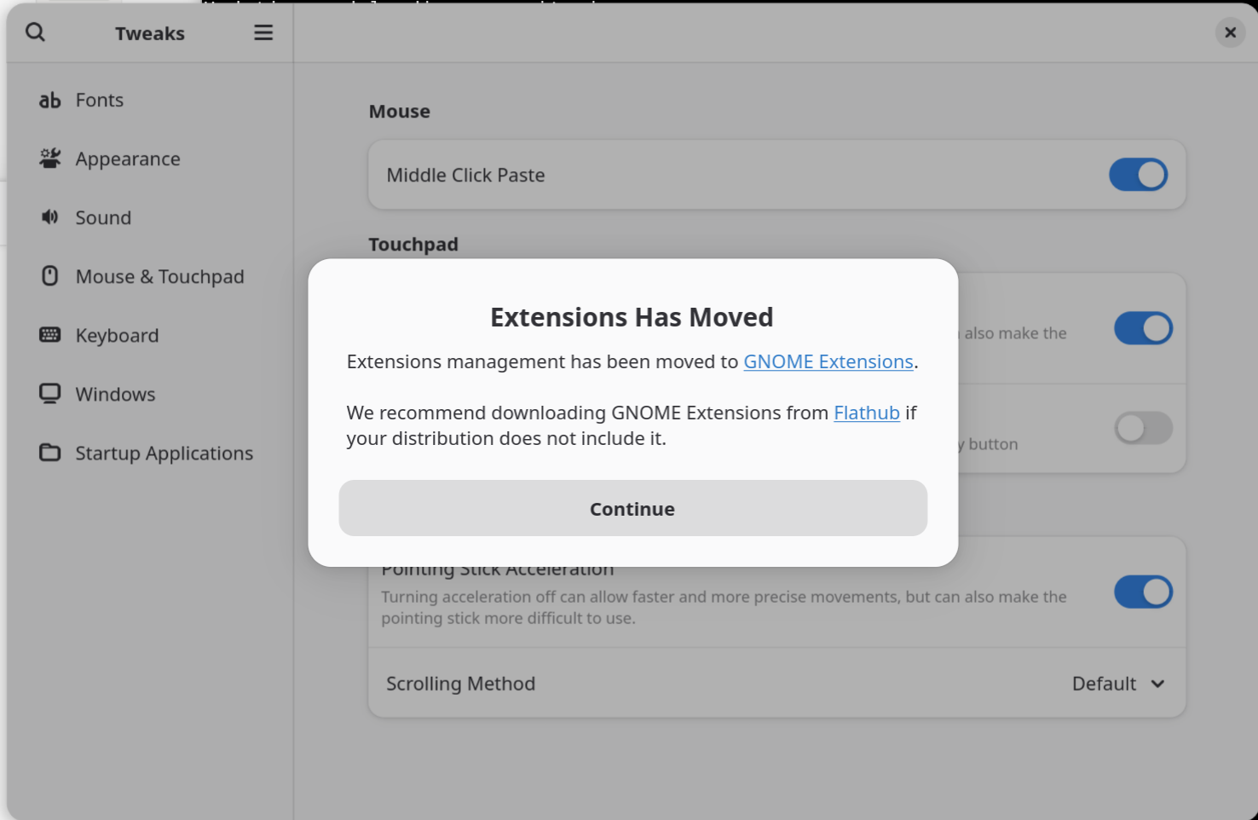
Optimization
Click Continue

Slide 48
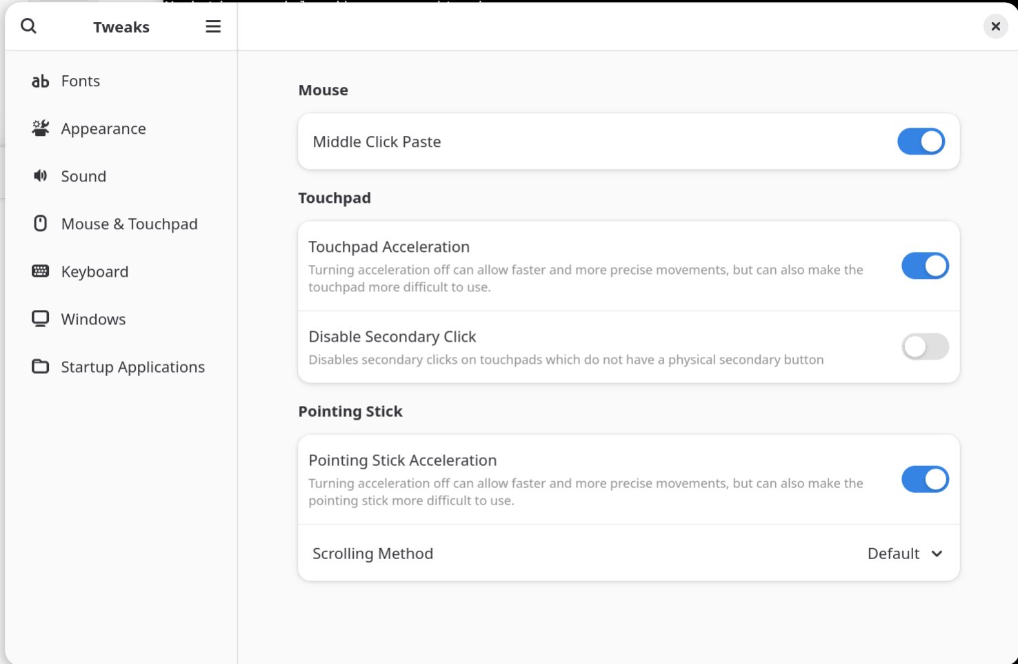
Optimization
Click on “Windows” in the
left menu

Slide 49
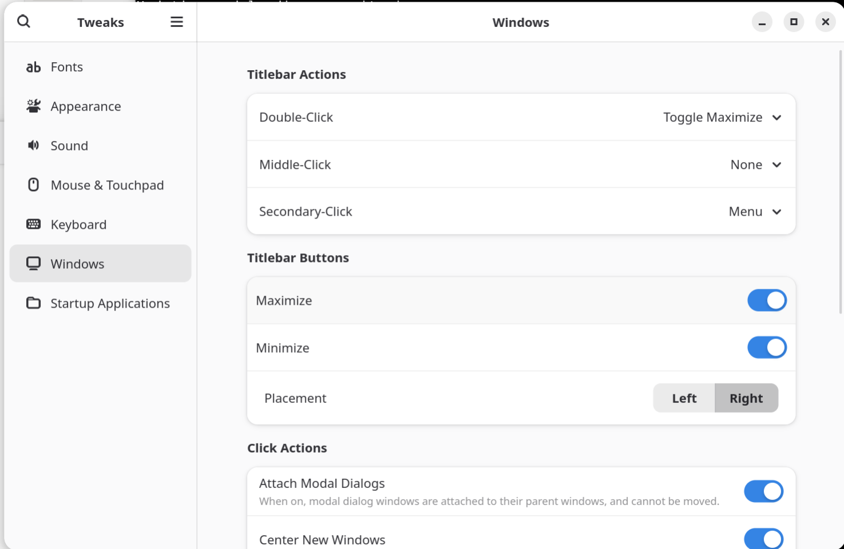
Optimization
Activate both the
Maximize & Minimize
Titlebar Buttons…
Then EXIT …(tweaks and the terminal session)

Slide 50
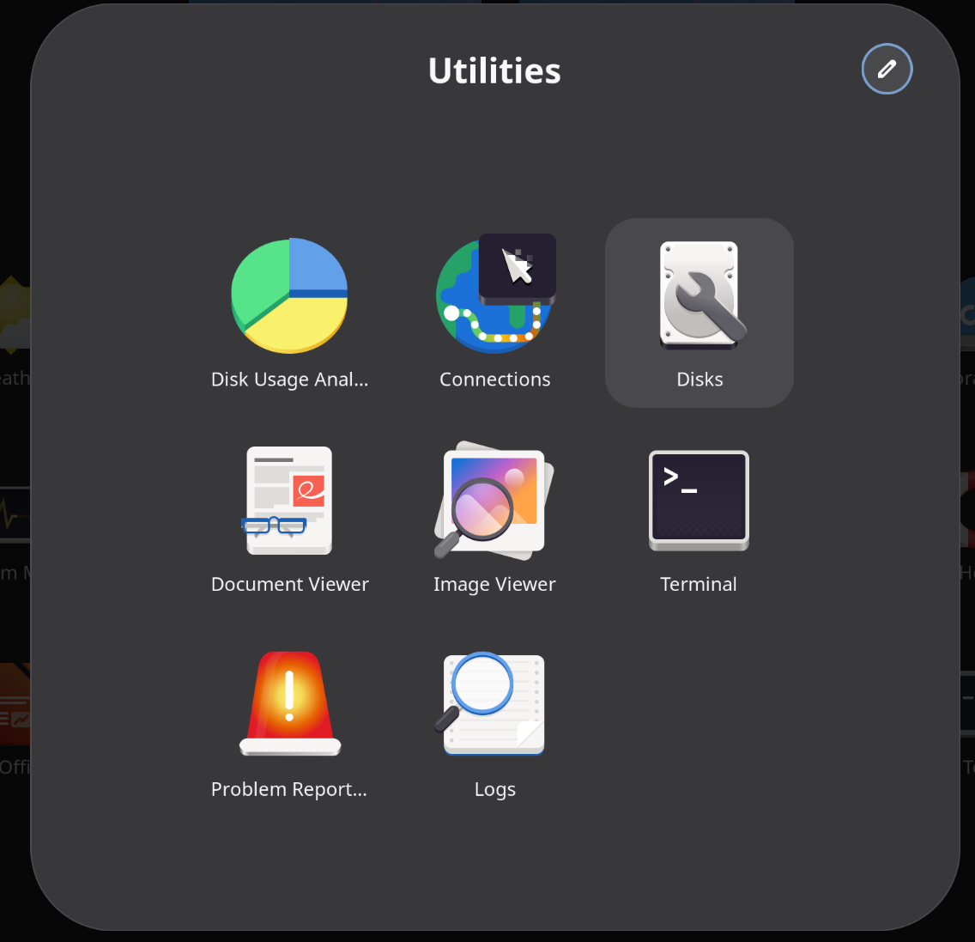
Optimization
STEP 7:
Resize the root volume
PLEASE NOTE: On some machines the Fedora First Boot sequence may have already done this behind the scenes. To test if you need to resize - run "df -h" in a terminal - if root ( / ) is not greater than 100GB - you need to execute this exercise. Of course this also depends on the actual size of the microSD card….

Slide 51
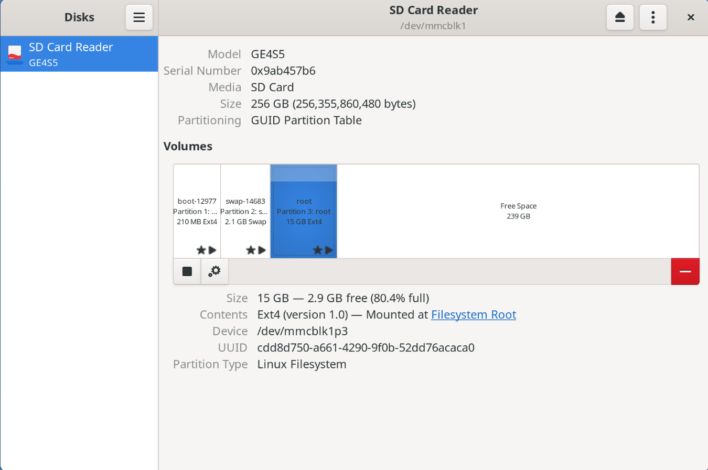
Optimization
Select the “root” volume

Slide 52
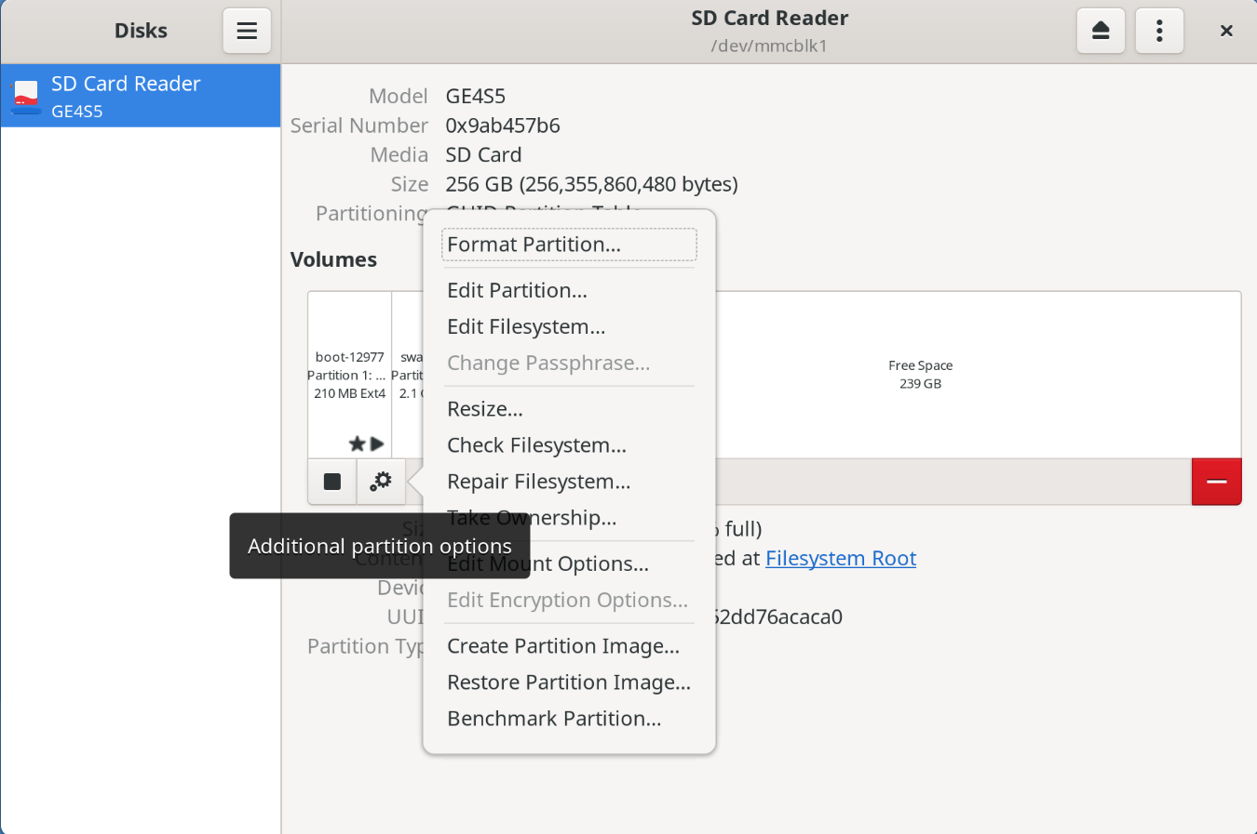
Optimization
Click on the gearbox…
The click on Resize.

Slide 53
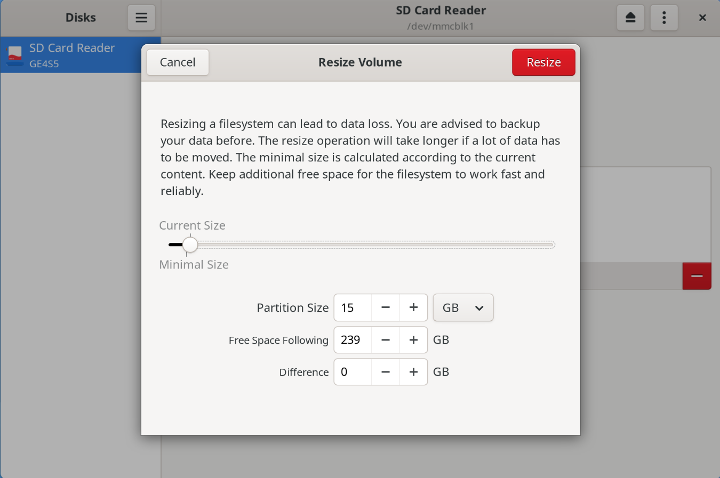
Optimization

Slide 54
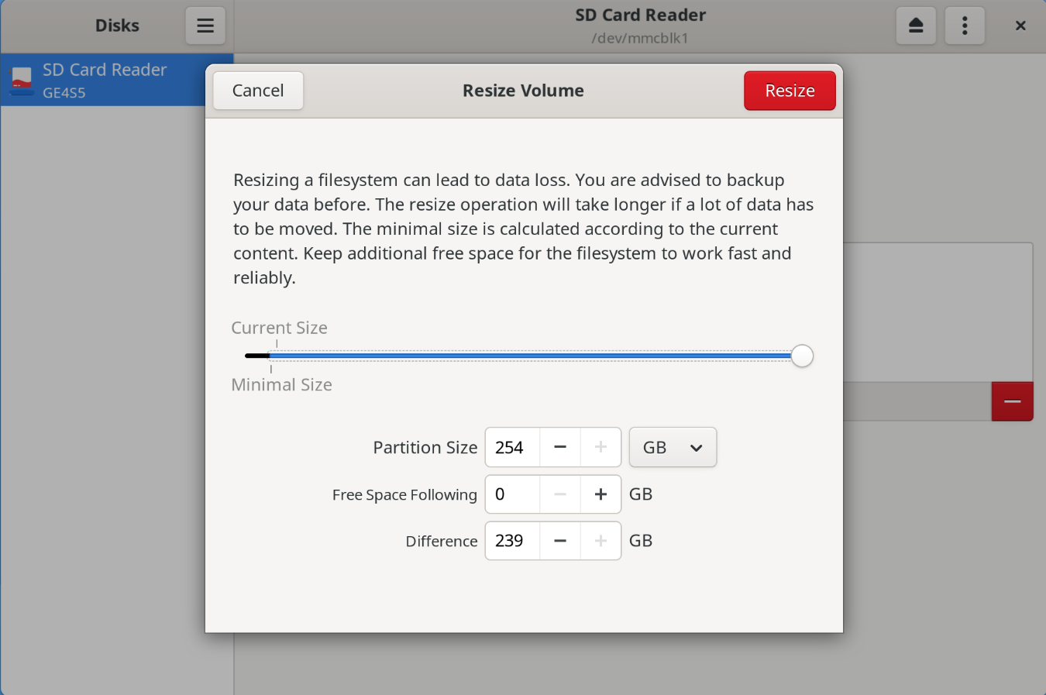
Optimization
Slide the expansion level as
far to the right as possible…
…then click Resize !!

Slide 55
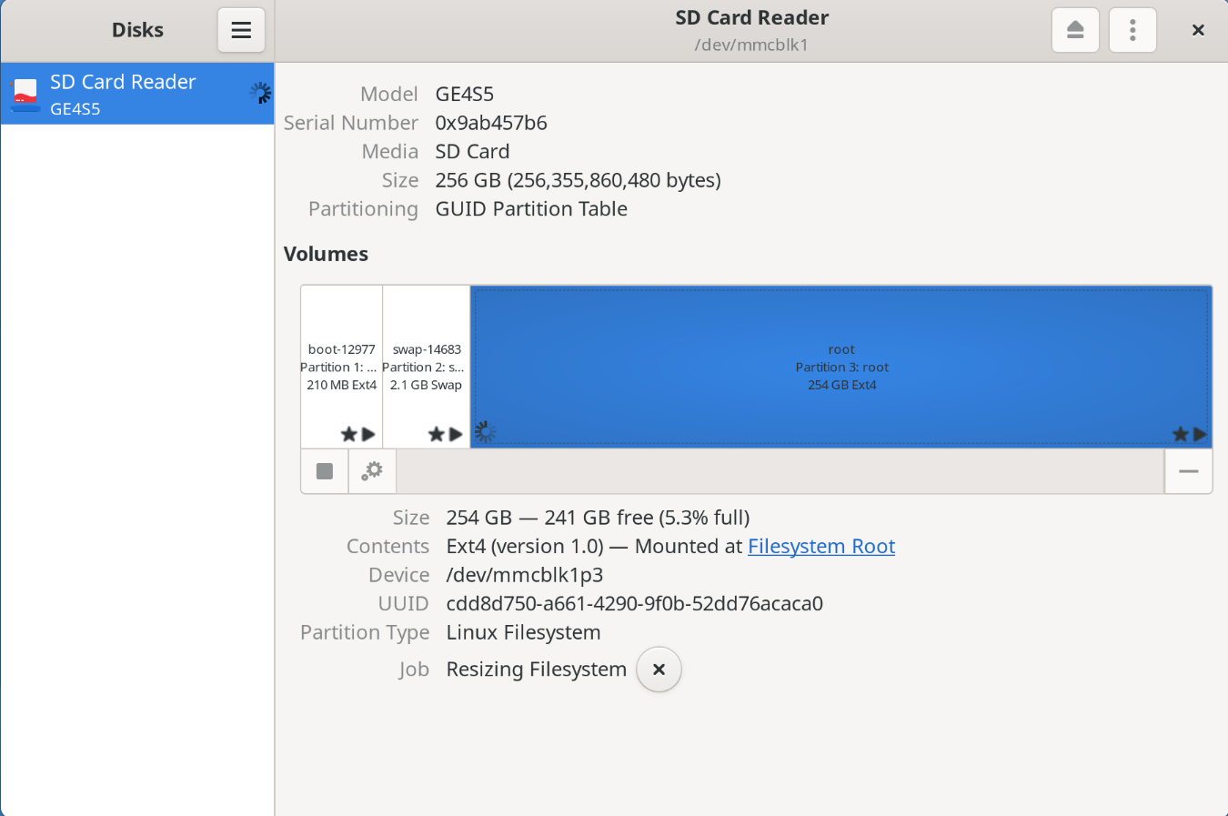
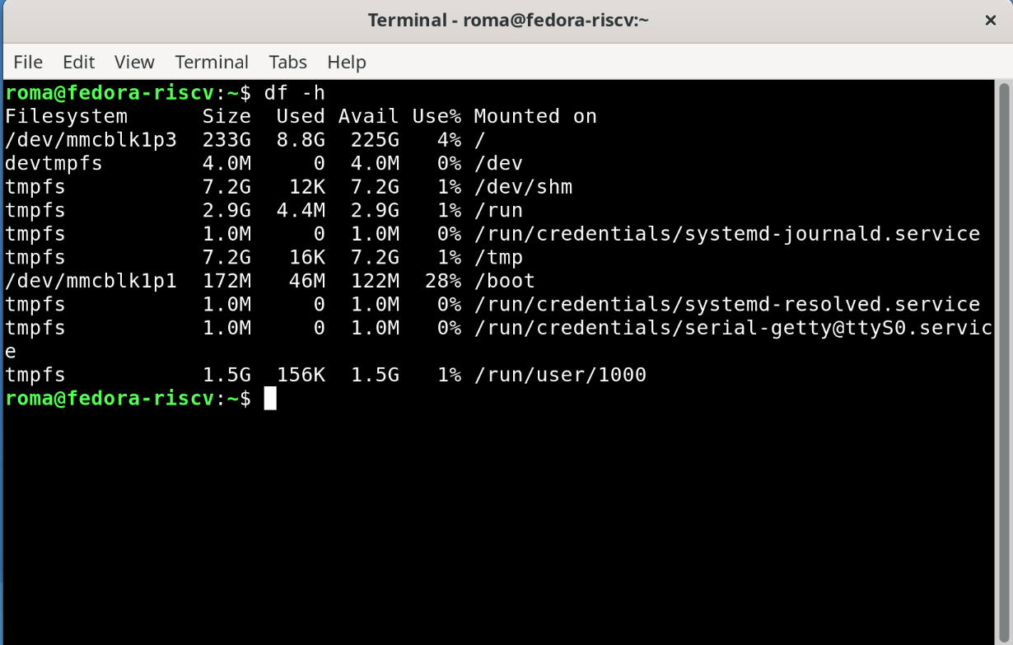
Optimization

Slide 56
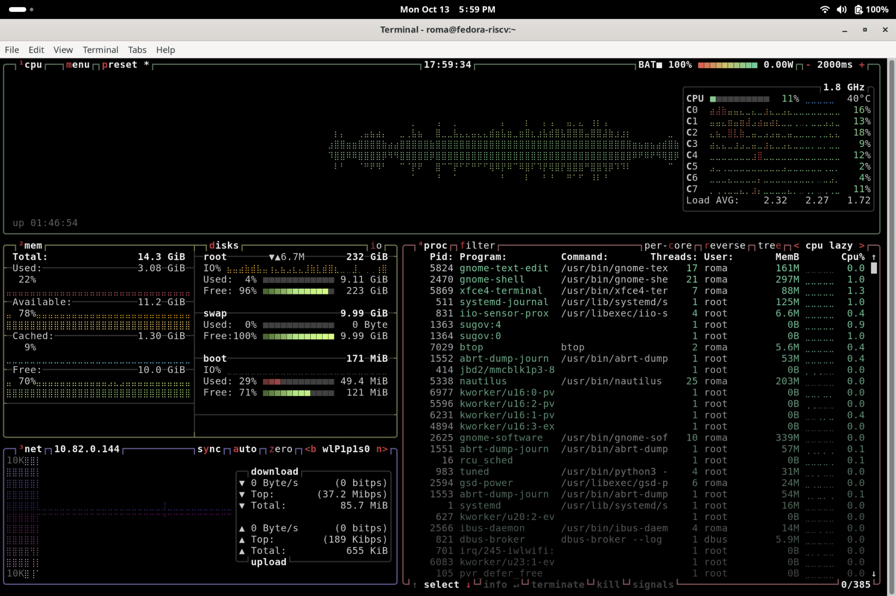
Optimization - Part 2
STEP 1:
Getting started with a look
inside…

Slide 57
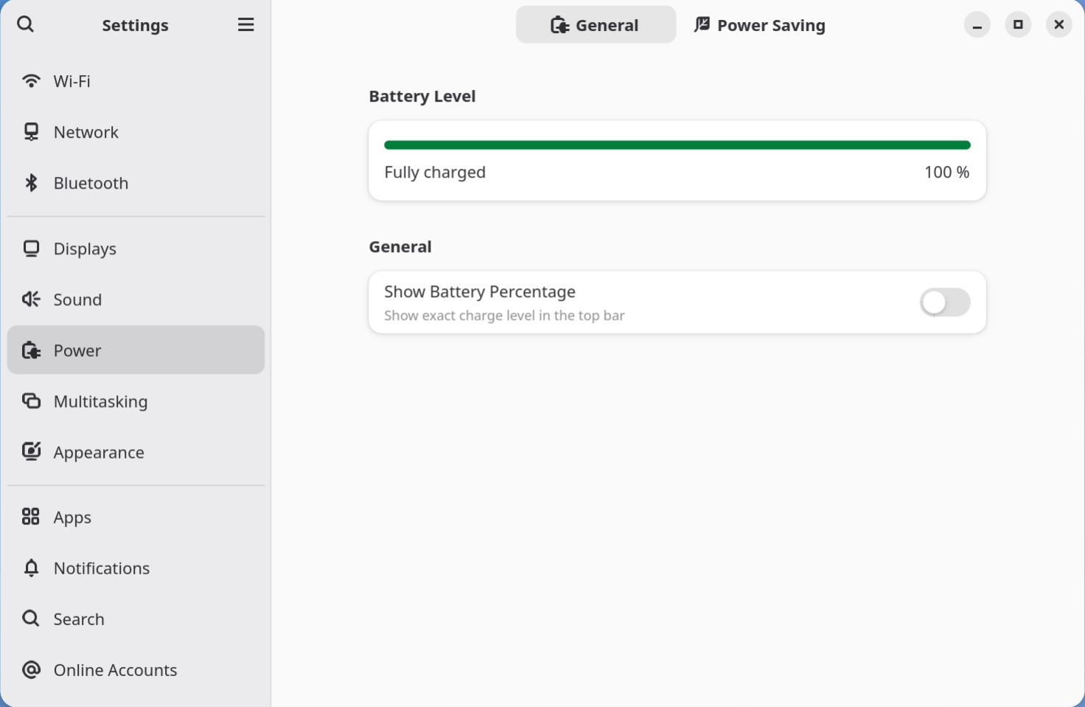
Optimization - Part 2
STEP 2:
Power Management
Enable “Show Battery
Percentage”

Slide 58
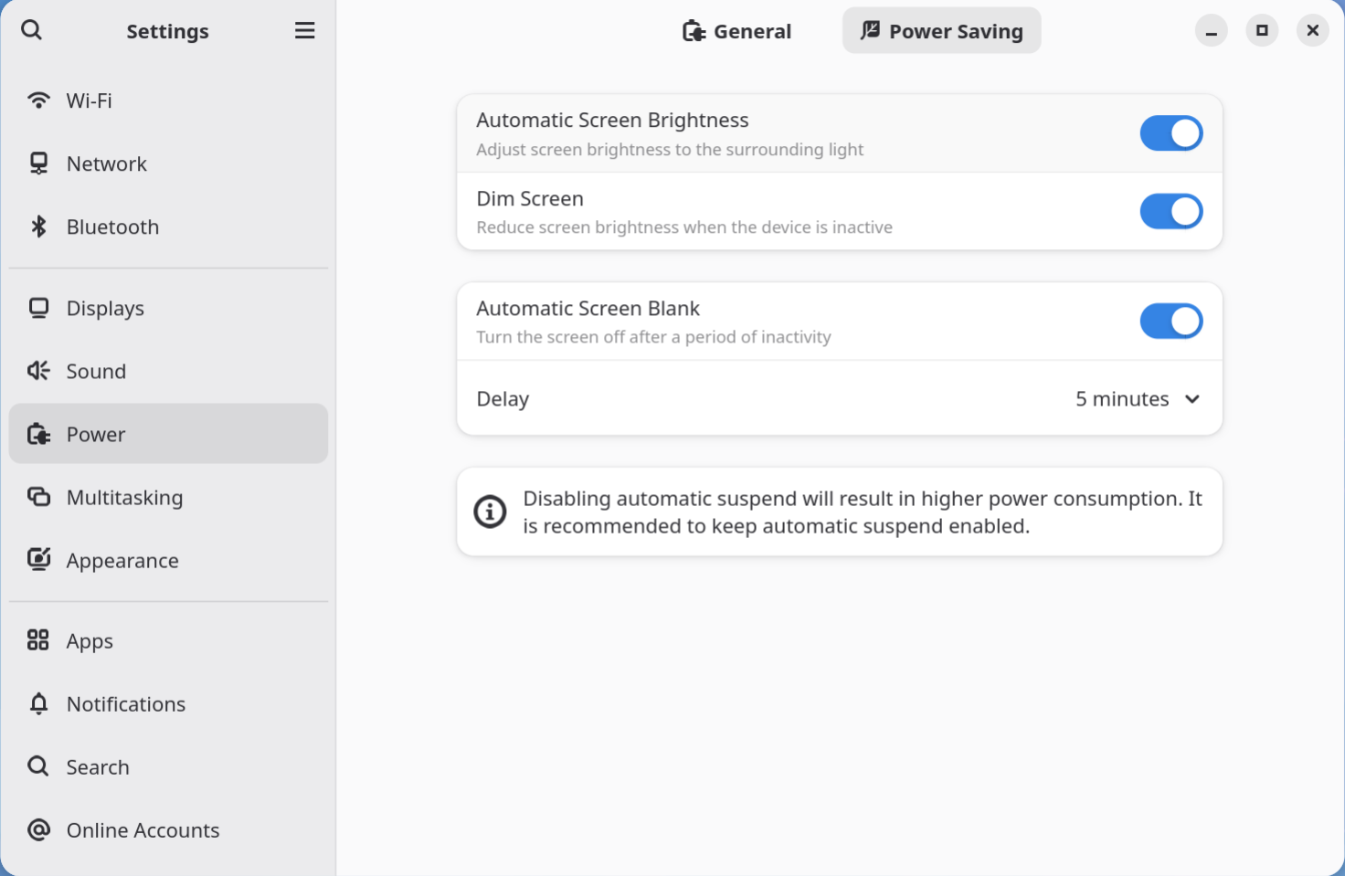
Optimization - Part 2
Click on the “Power Saving”
tab…

Slide 59
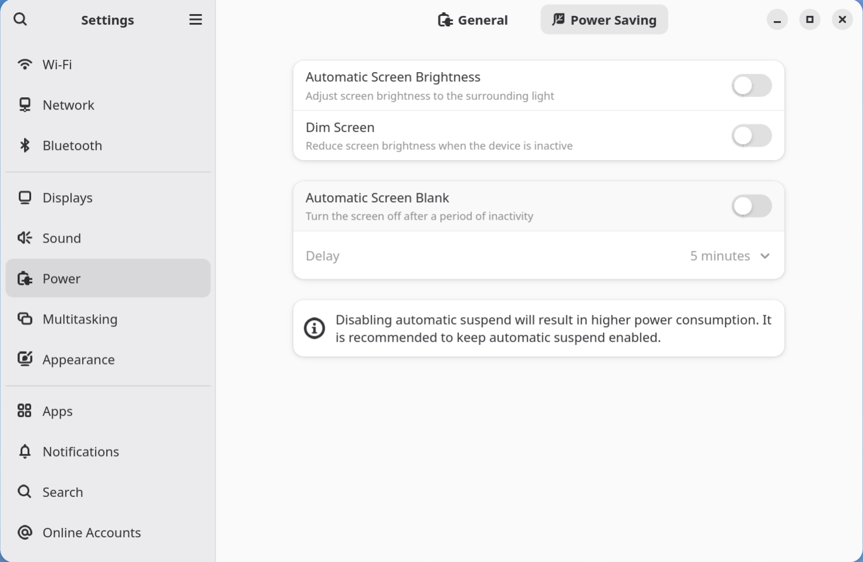
Optimization - Part 2
Disable:
Automatic Screen Brightness
Dim Screen
Automatic Screen Blank

Slide 60
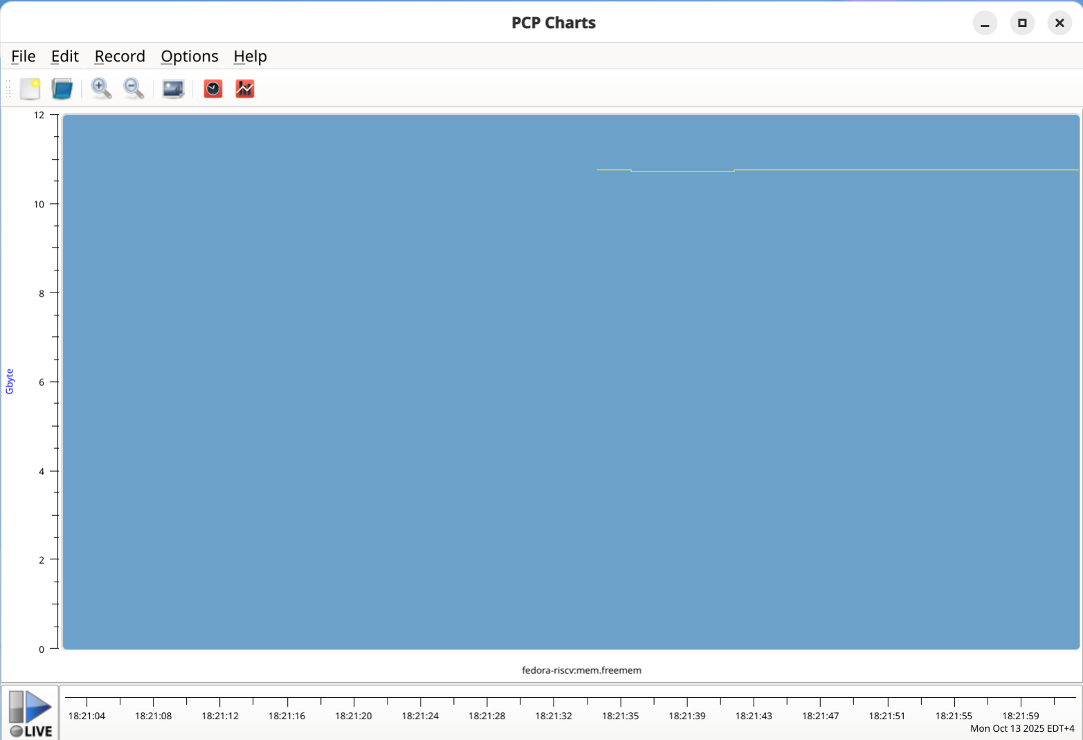
Optimization - Part 2
STEP 3:
Let’s talk about PCP…

Slide 61
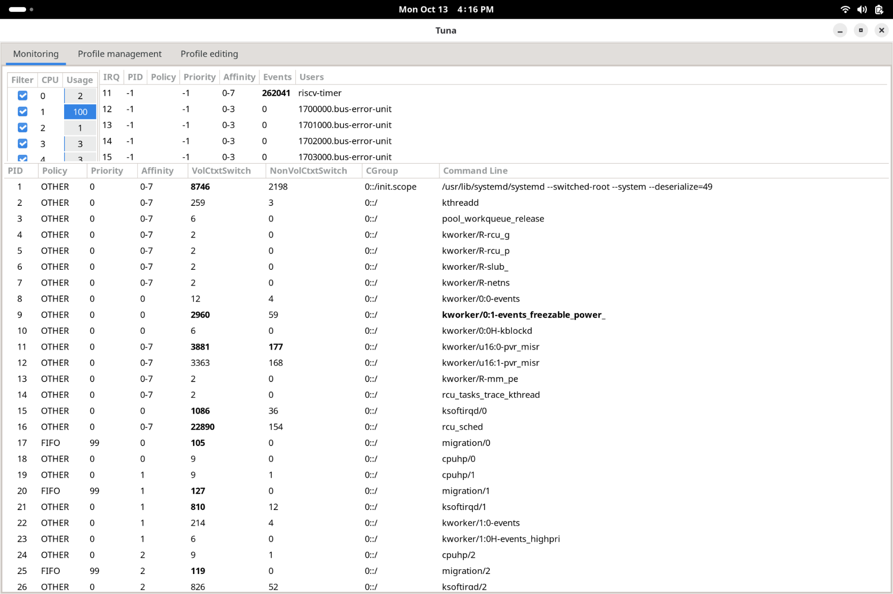
Optimization - Part 2
STEP 4:
TUNA & TuneD
Diving deep…

Slide 62
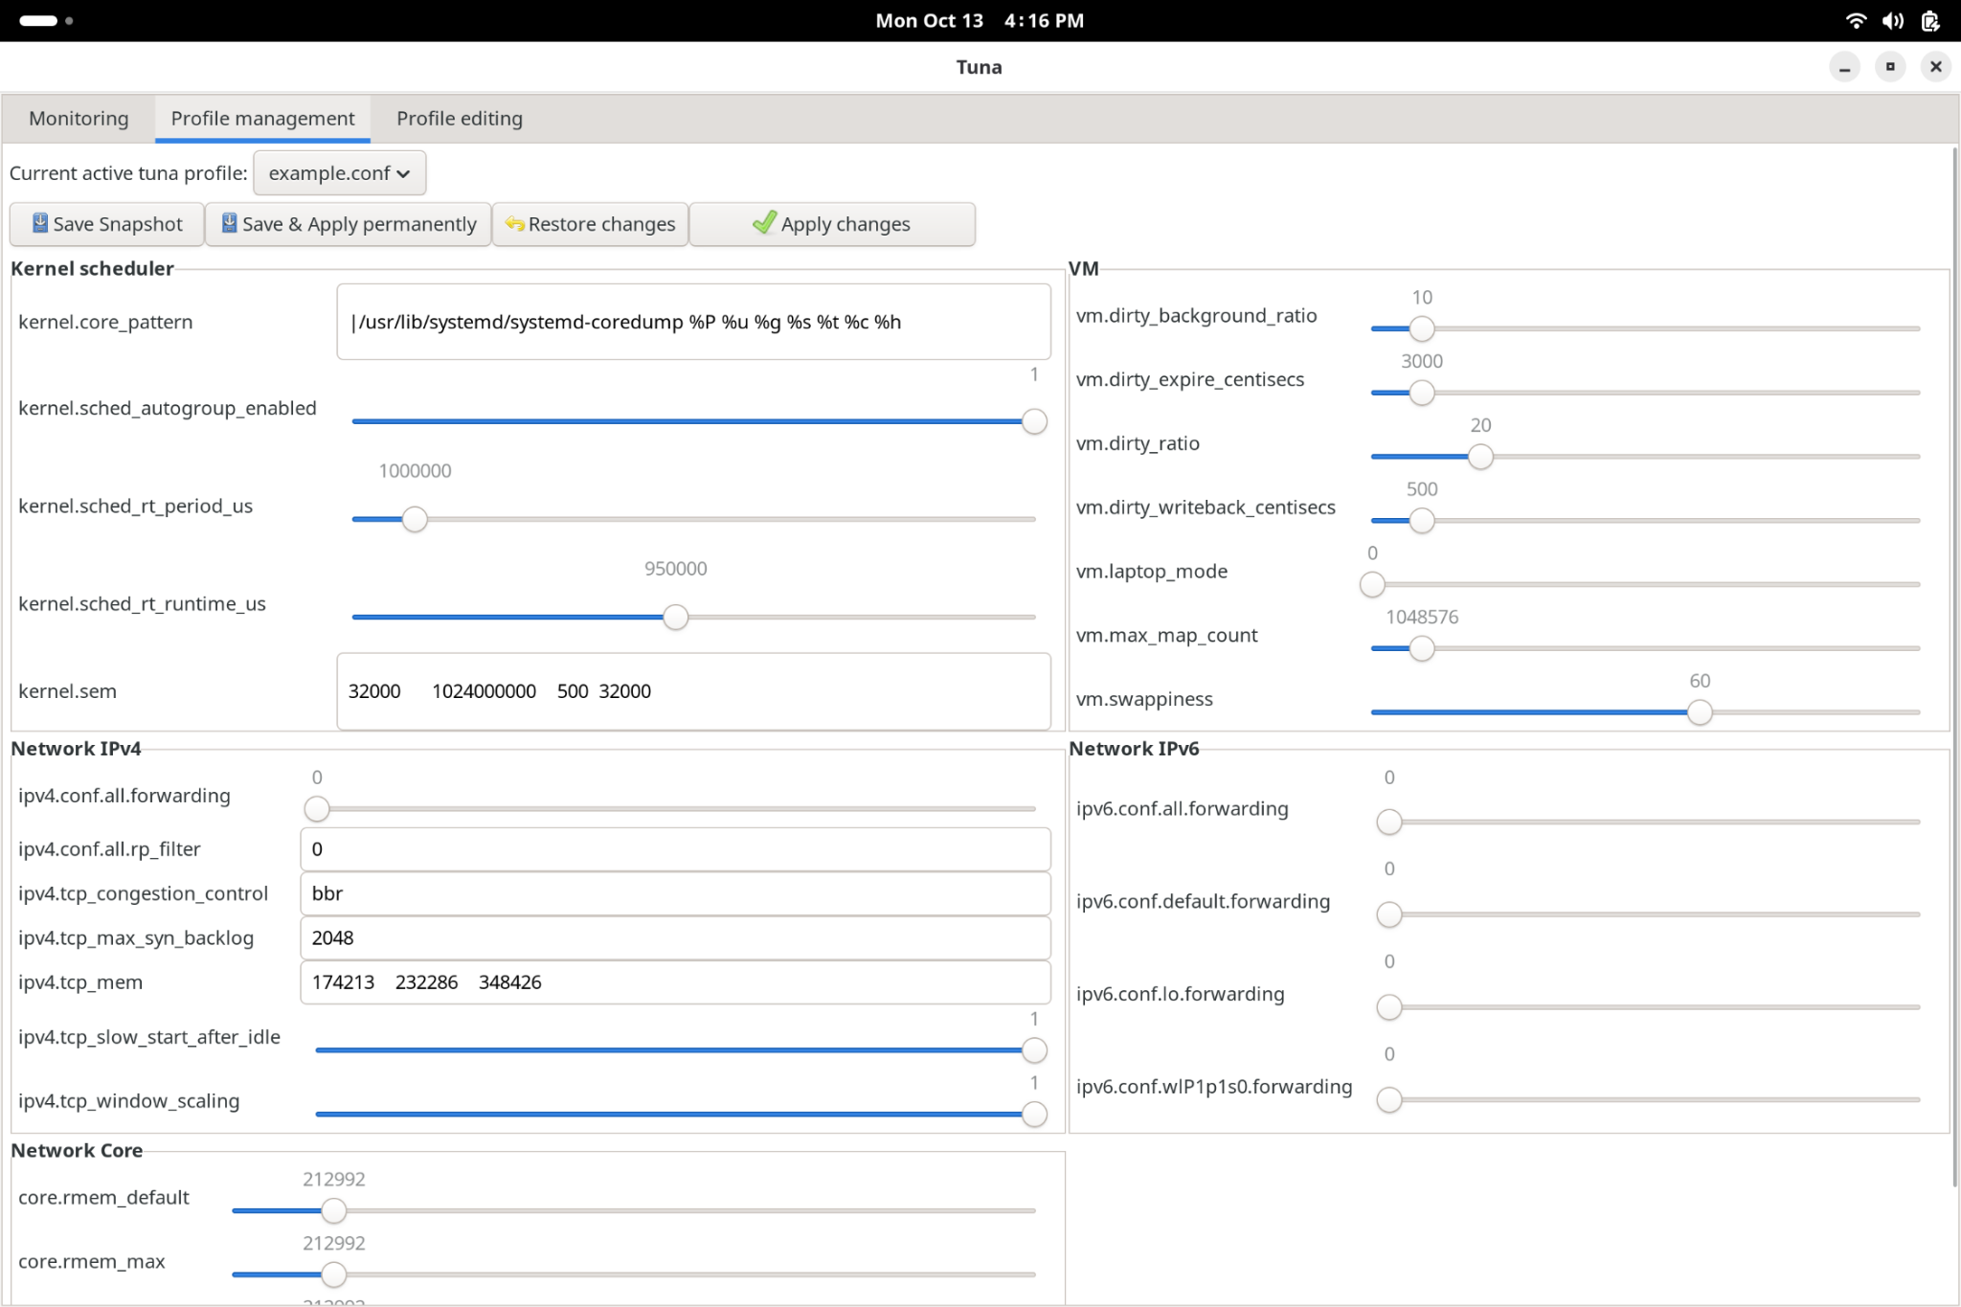
Optimization - Part 2
The Profile Management
tooling…

Slide 63
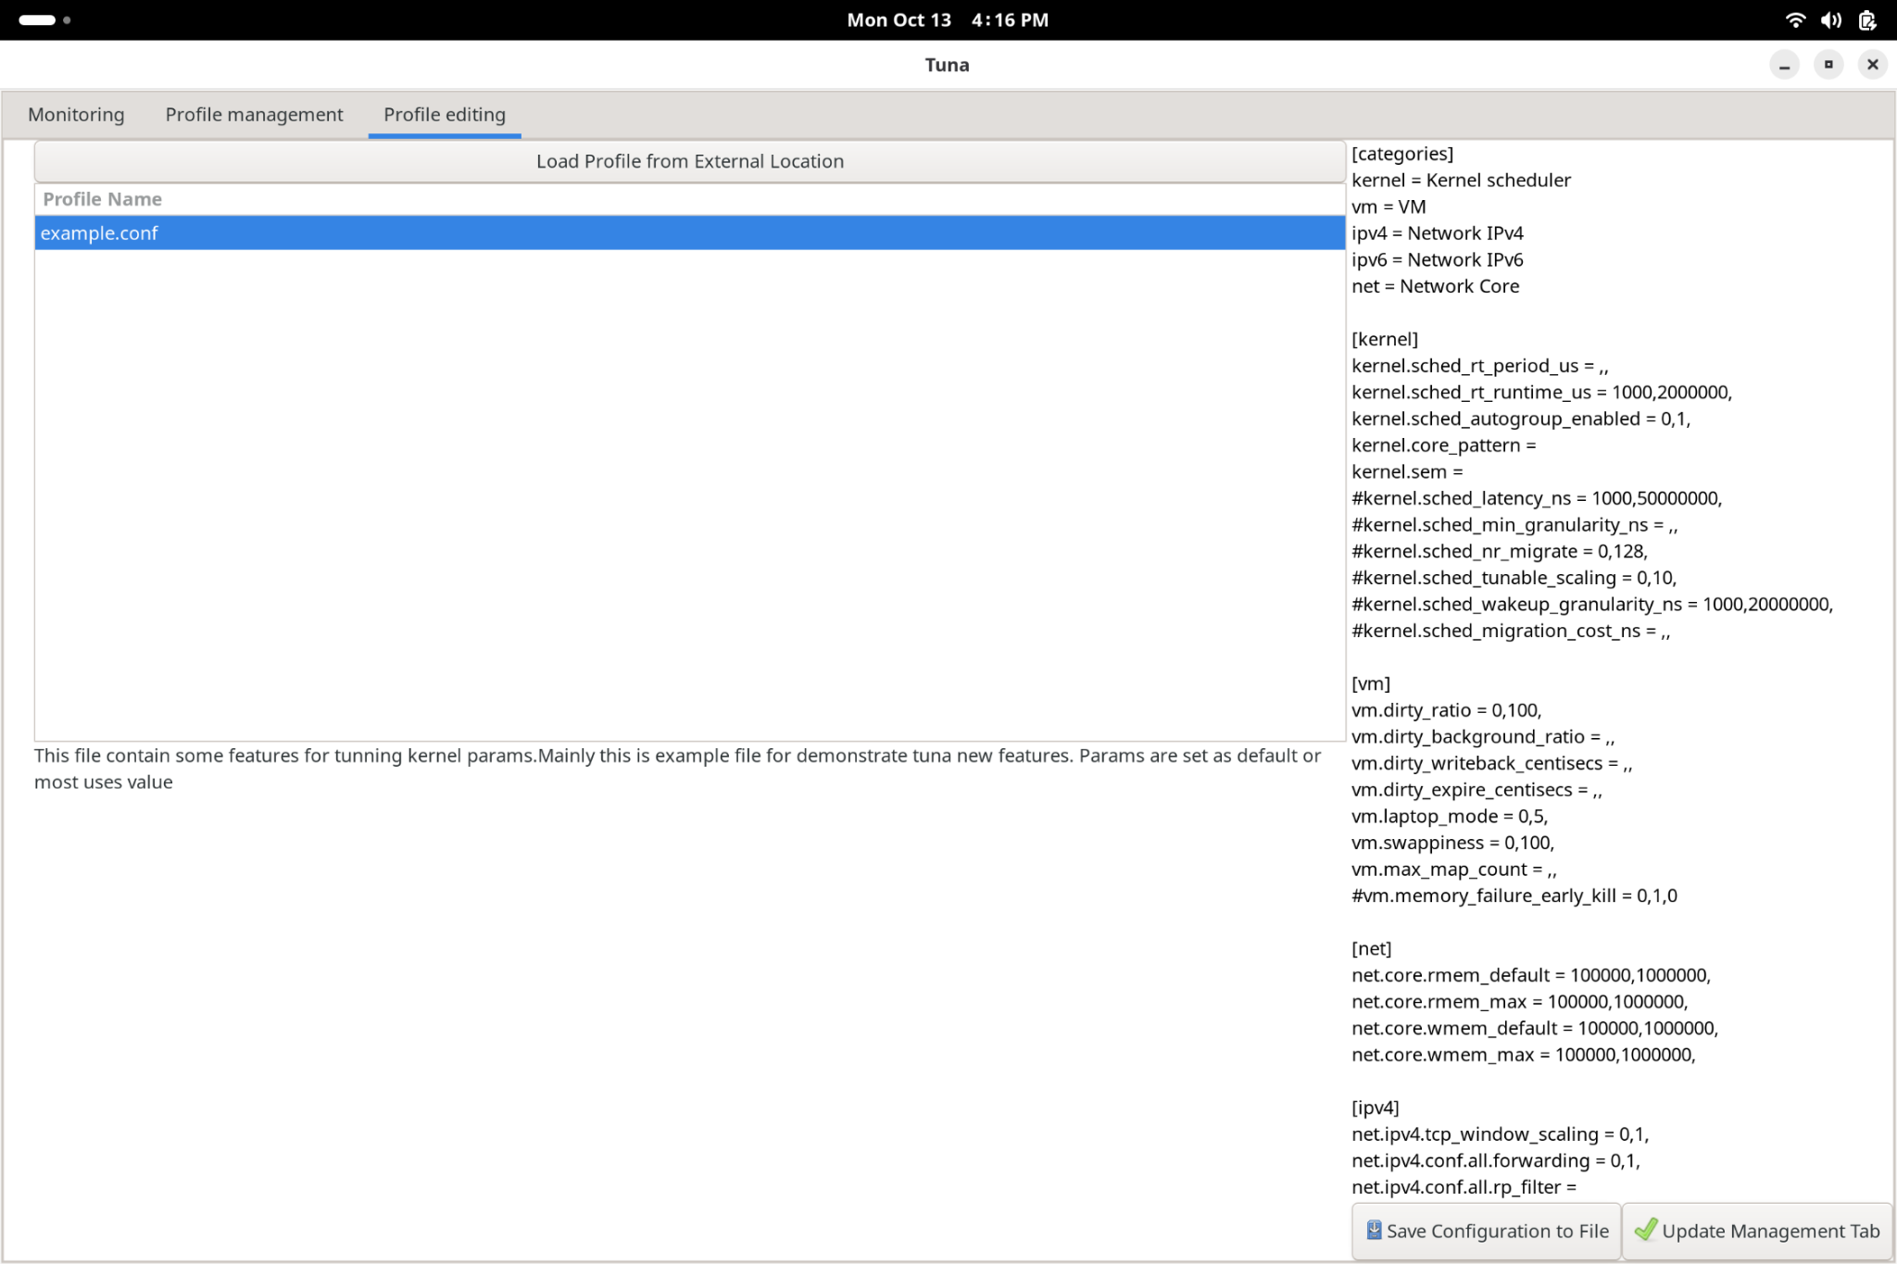
Optimization - Part 2
Profile Editing tooling…

Slide 64
Optimization - Part 2
STEP 5:
Updates… and a reboot…

Slide 65
Running AI

Slide 66
Running AI - DeepSeek7b via Web Interface
Configuring multiple windows
to best view the show…
Terminal (left half of screen) — BTOP running
Terminal (right top quarter of screen)
Nautilus file browser (bottom right corner)

Slide 67

Running AI - DeepSeek7b via Web Interface
Local AI
On RISC-V
Powered by Fedora 42 !!!

Slide 68
Running AI - DeepSeek7b via console
Configuring multiple windows
to best view the show…
Terminal (left half of screen) — BTOP running
Terminal (right top quarter of screen)
Terminal (bottom right quarter of screen)

Slide 69
Running AI - DeepSeek7b via console
Configuring multiple windows
to best view the show…
Terminal (left half of screen) — BTOP running
Terminal (right top quarter of screen)
Terminal (bottom right quarter of screen)

Slide 70

Running AI - DeepSeek7b via console (w/NPU)
$ sudo /opt/eswin/sample-code/npu_sample/qwen_sample/bin/es_qwen2 \
/opt/eswin/sample-code/npu_sample/qwen_sample/src/deepseek_7b_1k_int8_peer/config.json

